Slide 1
Analysis of Actin-Myosin Kinetics: Influence of ATP Concentration on Step Size
Ashutosh Yadav
2020BB10012
Under Guidance of – Prof. Ravi Krishnan Elangovan

Slide 2
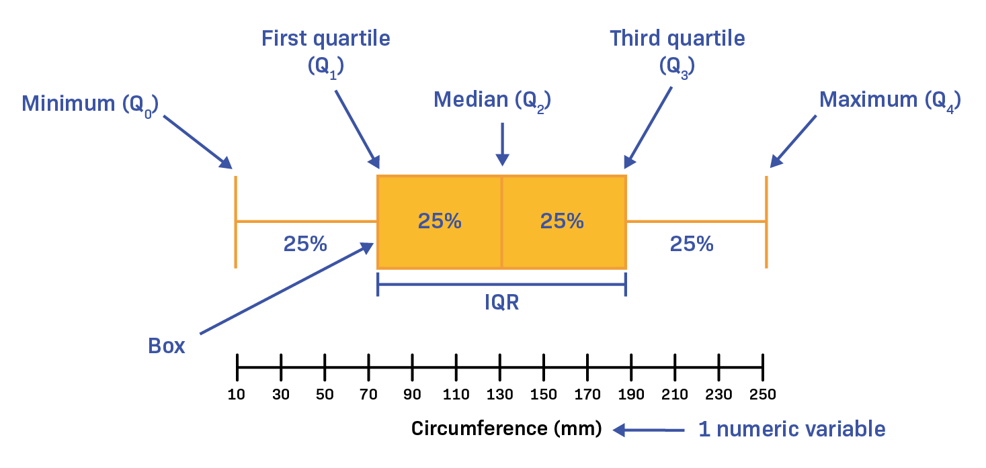
Data Preprocessing
Outliers in each dataframe(box plots):
7 different conc., with 30-40 tracks each(containing x, y coordinate of particles at every 10 ms)
The dataframe of 0.1 mM ATP has significant number of outliers
The outliers can't be removed directly as they are in time series
Handled these outliers during later analysis
Data* for | Number of Outliers | % of Total
0.001 mM ATP | 100 | 6.86
0.025 mM ATP | 64 | 4.62
0.05 mM ATP | 1 | 0.07
0.1 mM ATP | 200 | 14.63
0.25 mM ATP | 5 | 0.4
0.5 mM ATP | 7 | 0.65
2 mM ATP | 1 | 0.11
*Data Ref: Sneha Kumari, PhD Student

Slide 3
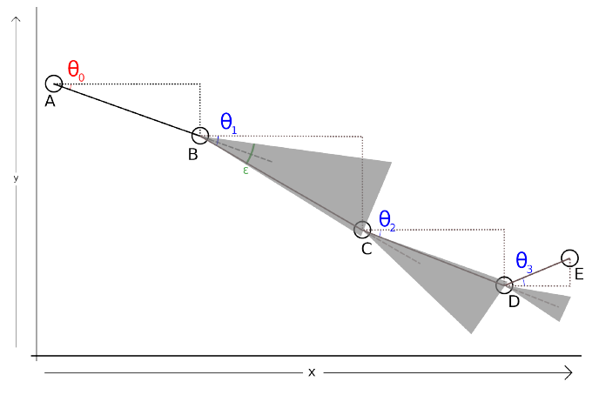
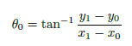
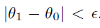
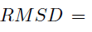
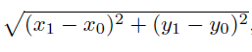
Linear Paths
The particle motion is random
To analyze the step sizes only linear paths are considered
Threshold angle, which is maximum change in angle between two steps
The threshold angles considered for analysis are – 15 and 30 deg

Slide 4
The Trajectory of Particles
Analysis is done for 0.001 mM ATP data
Analyzing the points where the threshold(15 deg) is crossed and linear paths
Change in color(to blue) means the threshold is crossed
Points in Blue are in a linear path(with threshold of 15 degrees)

Slide 5
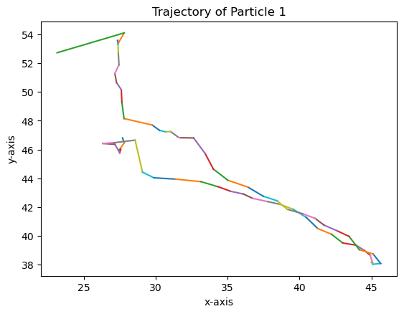
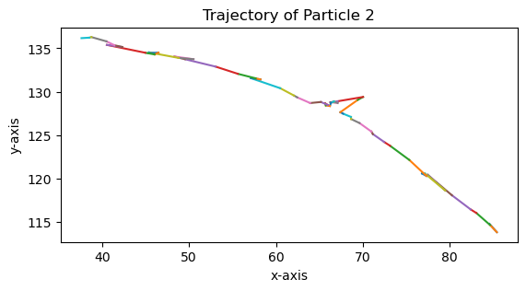
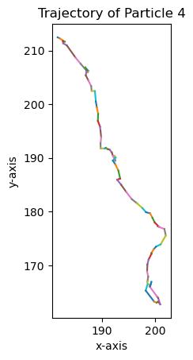
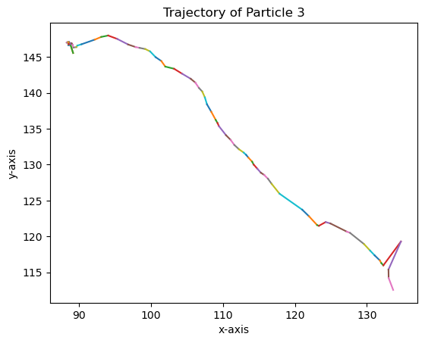

Slide 6
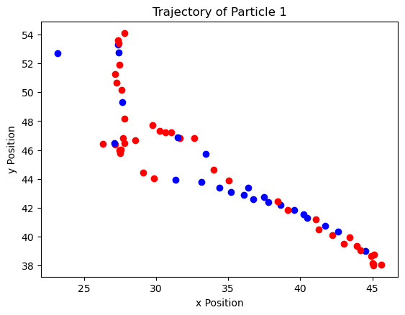
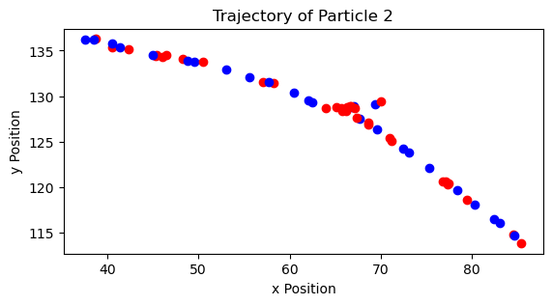
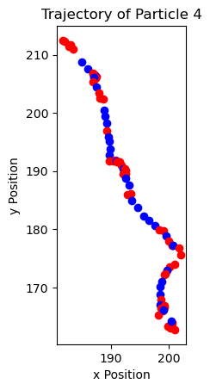
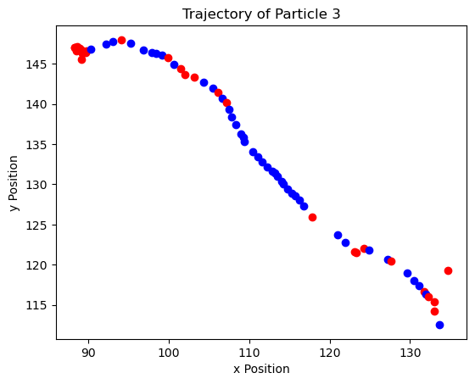
Linear steps in the trajectory
Analyzing the points where the threshold (15 deg) is crossed and linear paths
Change in color (to blue) means the threshold is crossed
Points in Blue are in a linear path (with threshold of 15 degrees)

Slide 7
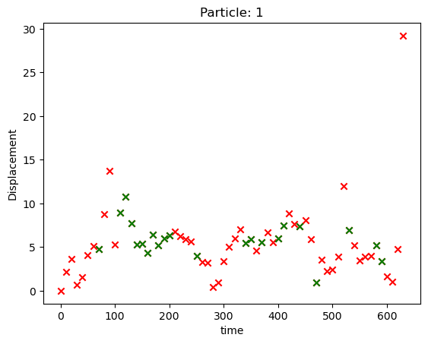
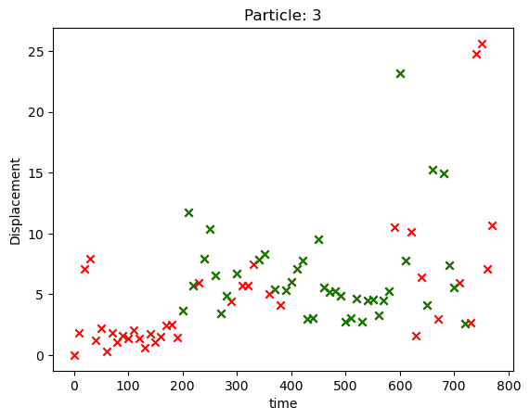
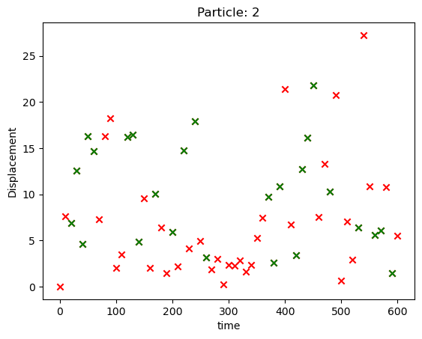
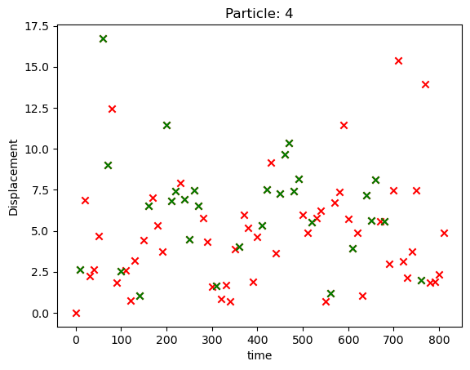
Displacement of Particle vs Time
Analysis is done for 0.001 mM ATP data
Displacement at every interval of 10 ms is plotted corresponding to time
Marked the steps(green) which are in a linear path

Slide 8
Displacement Histograms (Threshold of 15/30deg)
Analysis of the step sizes taken by particles at different ATP conc.
How are the step sizes related?
Plotted the histograms for all 7 concentrations for both the thresholds of 15 and 30 degrees
There are three different cases taken into account for each:
Linear paths having minimum 2 steps
Linear paths having minimum 3 steps
Linear paths having minimum 4 steps

Slide 9
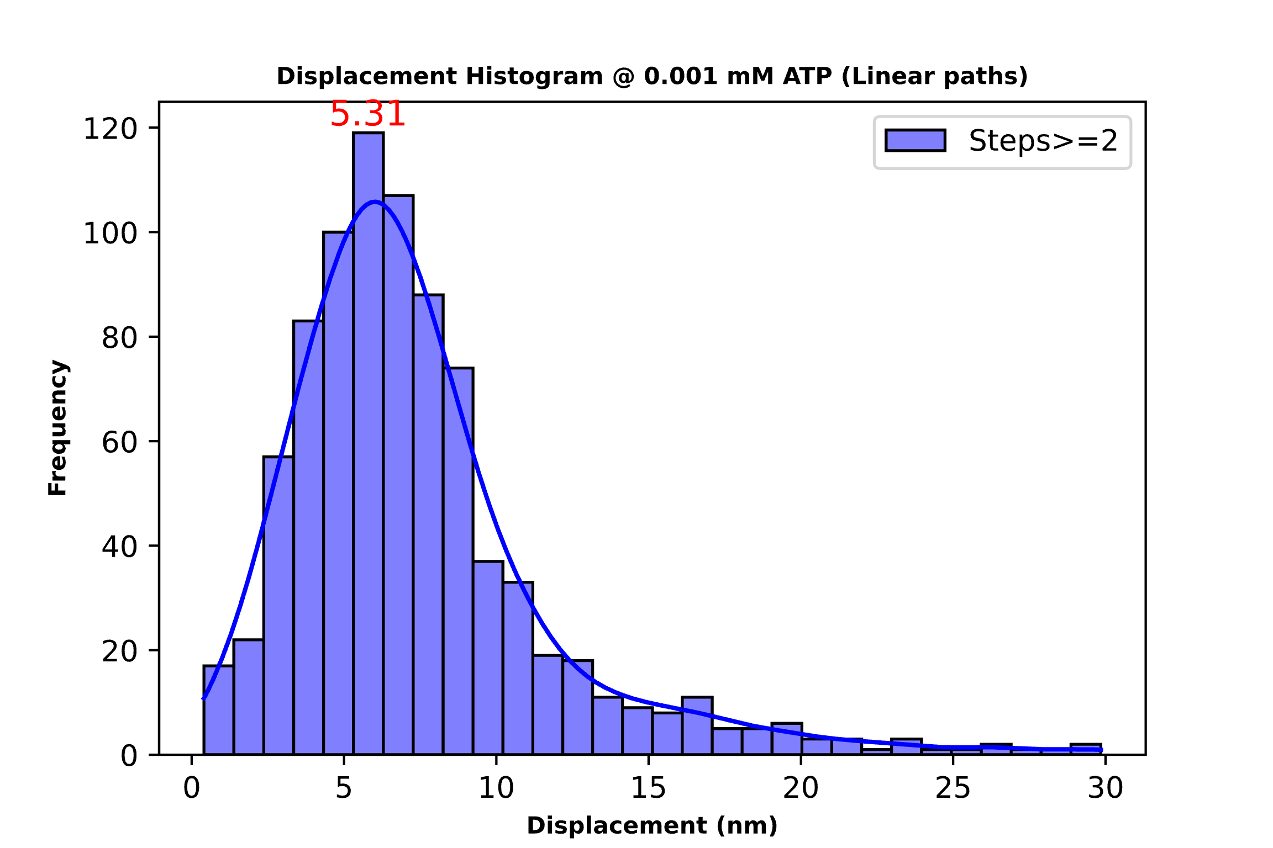
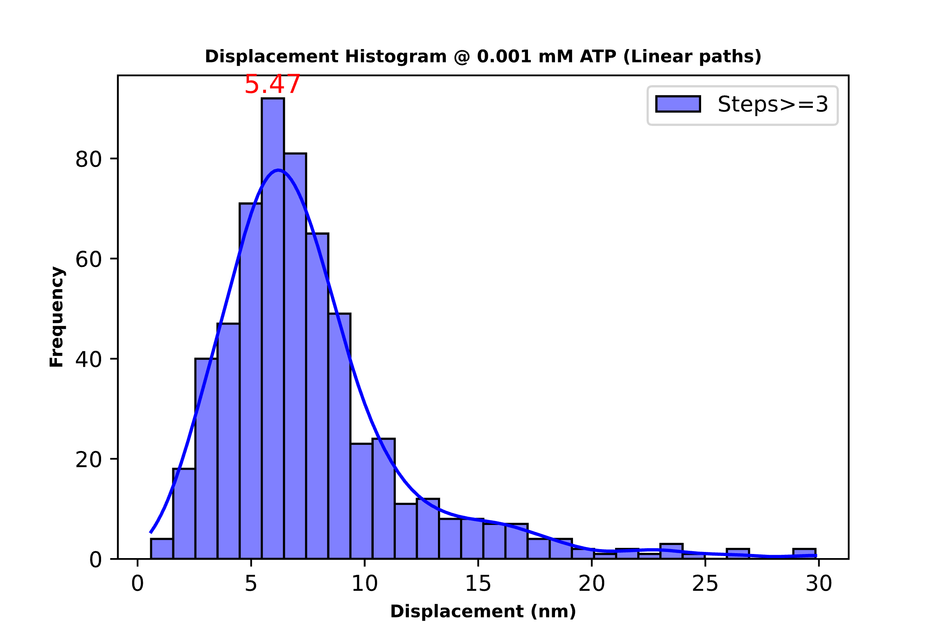
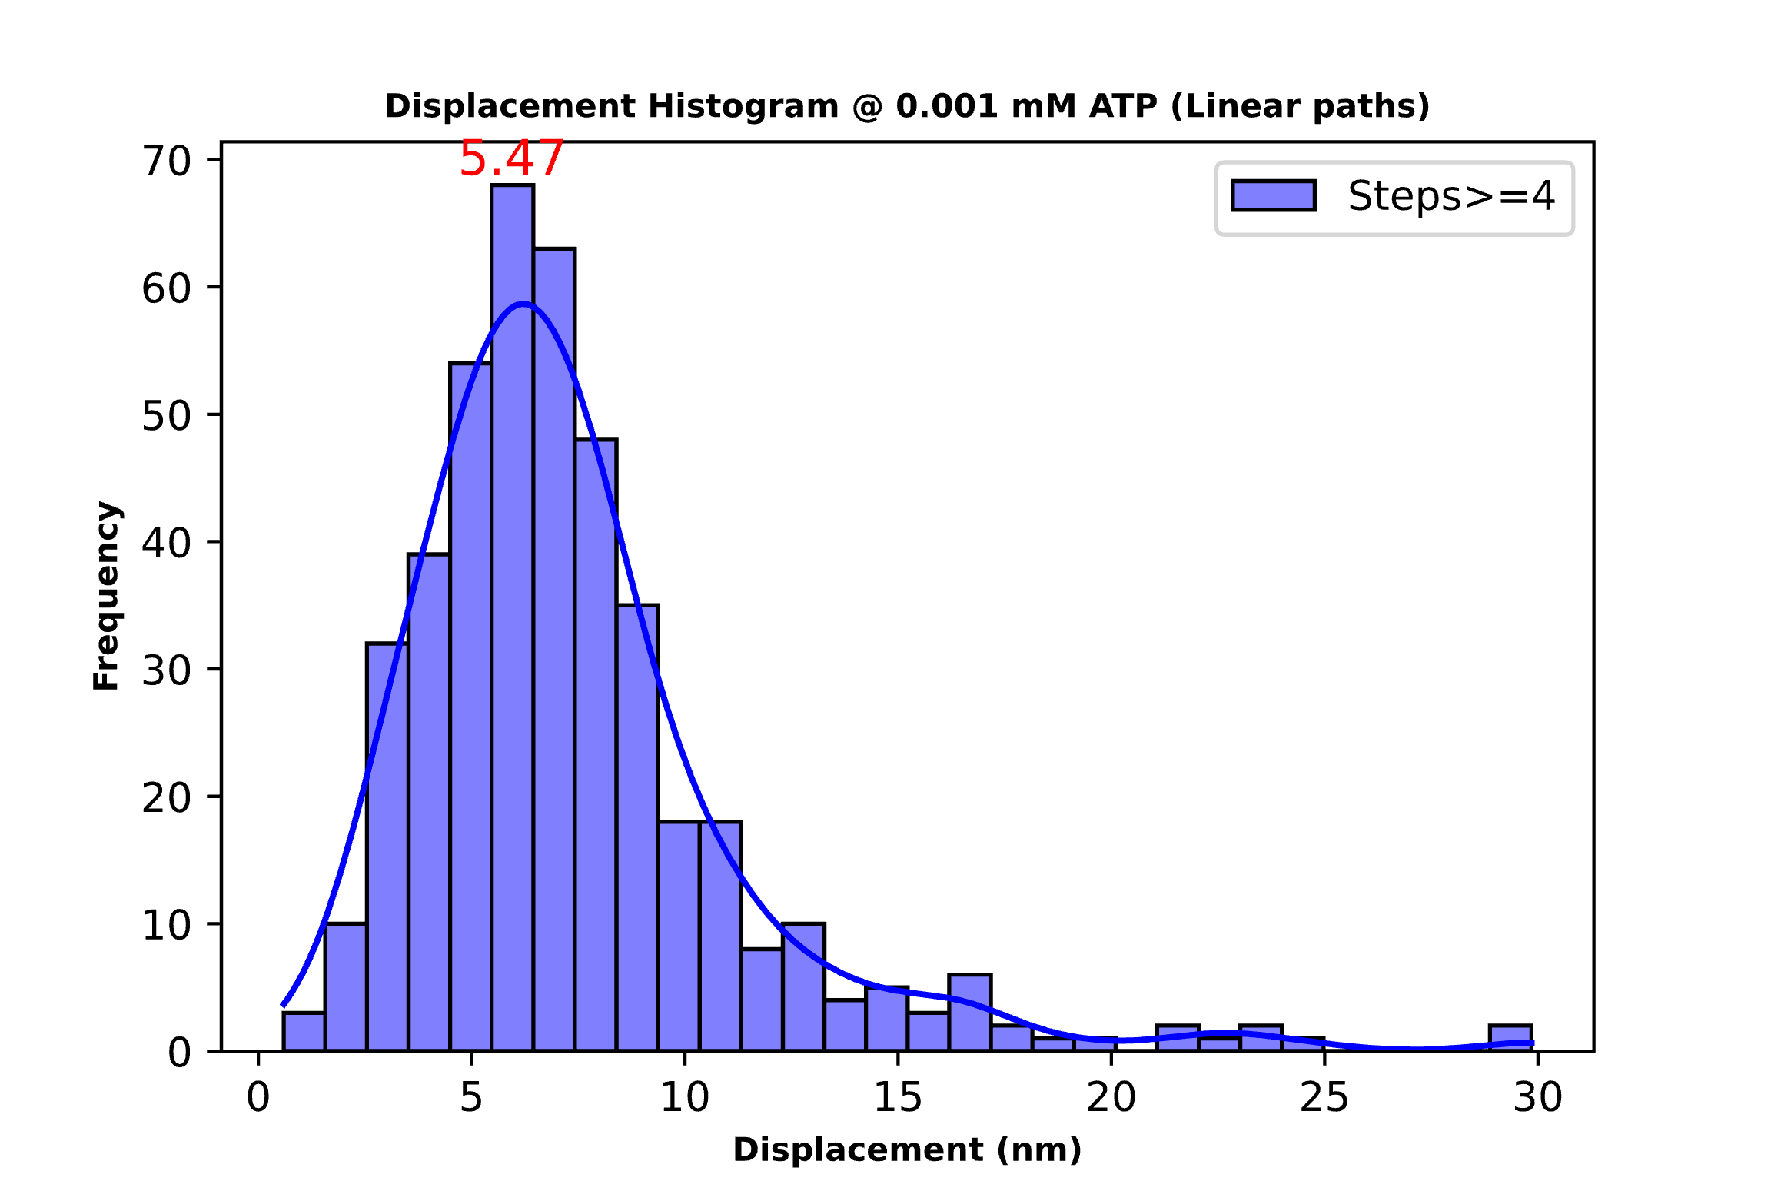
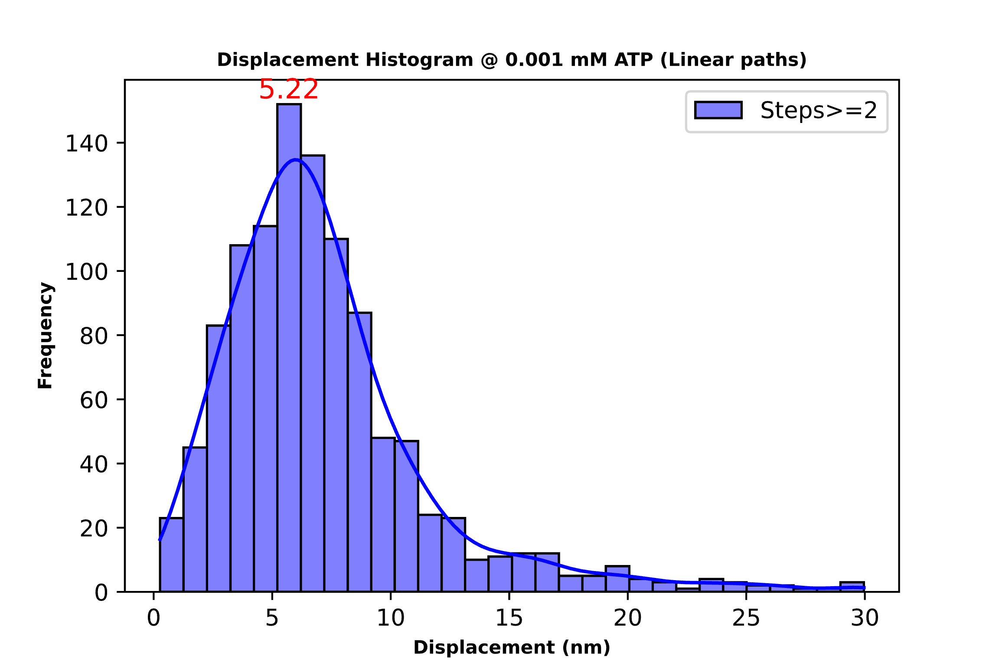
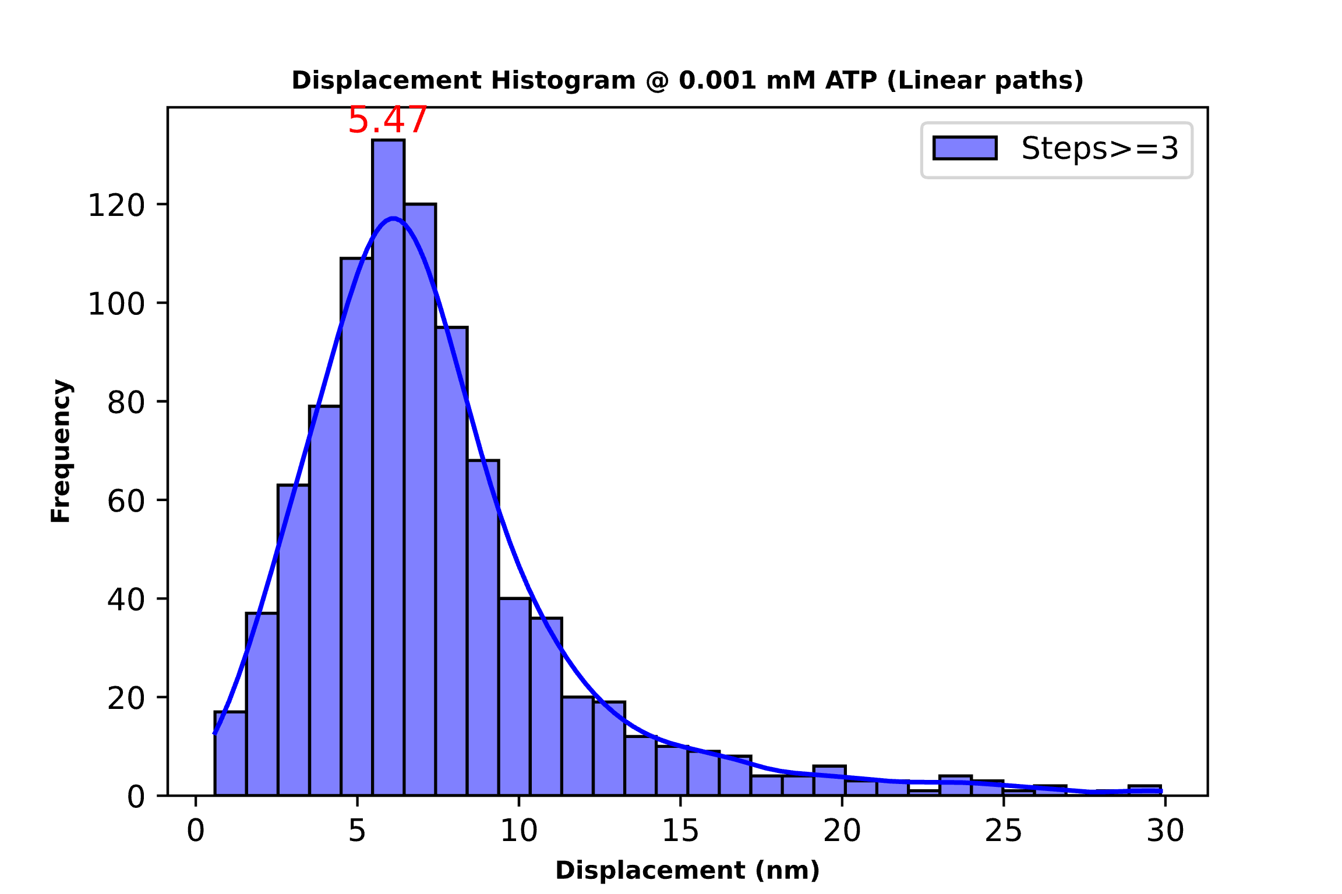

0.001 mM ATP Threshold 15 deg(Above) and 30 deg(Below)
Total steps: 847
Mean step size: 7.37
Total steps: 589
Mean step size: 7.55
Total steps: 436
Mean step size: 7.35
Total steps: 1087
Mean step size: 7.16
Total steps: 909
Mean step size: 7.37
Total steps: 795
Mean step size: 7.32

Slide 10
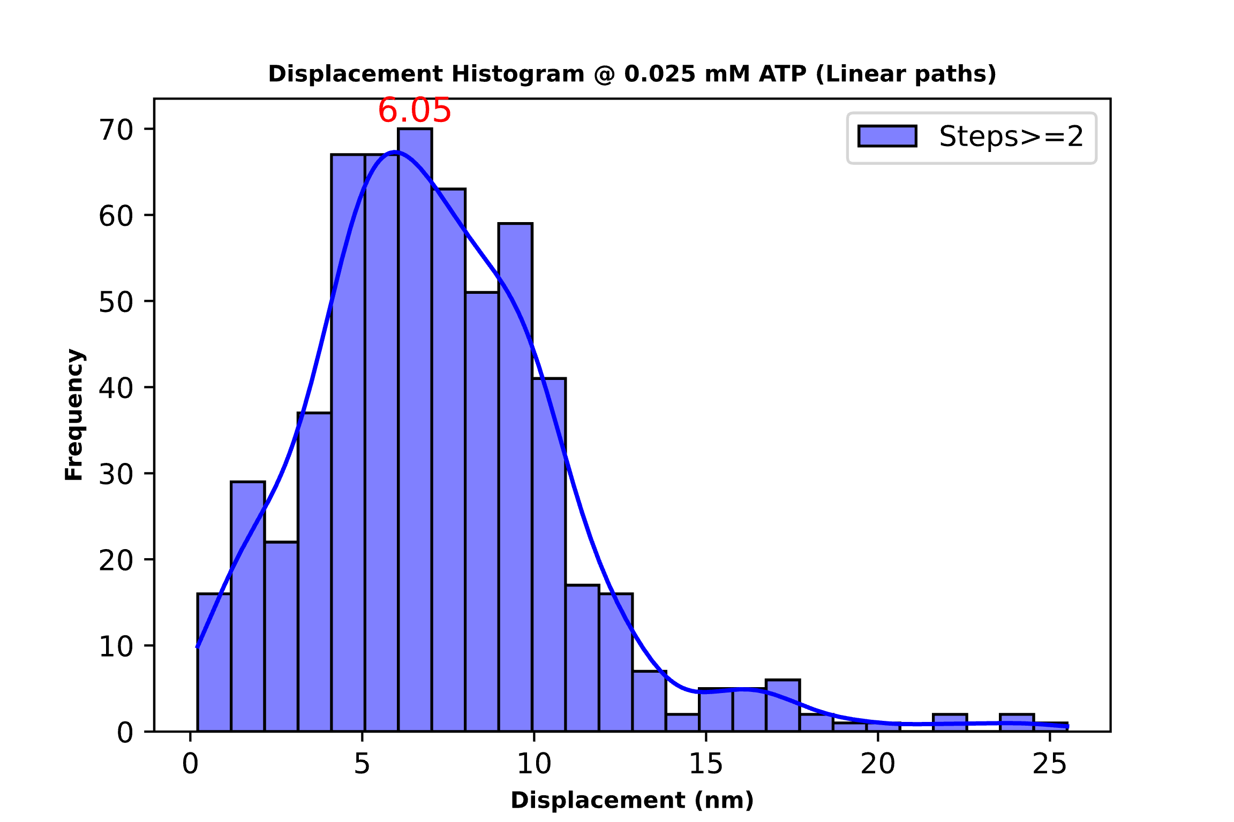
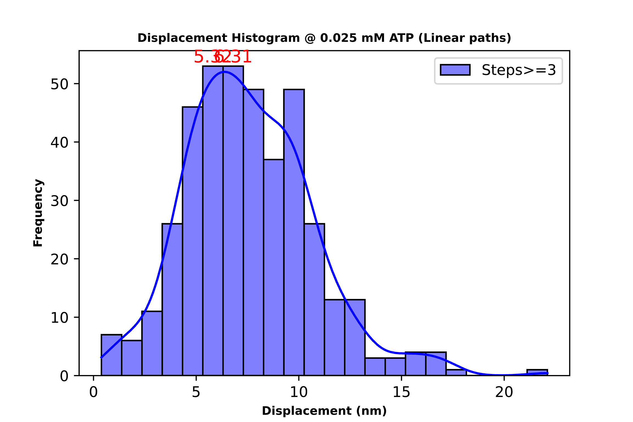
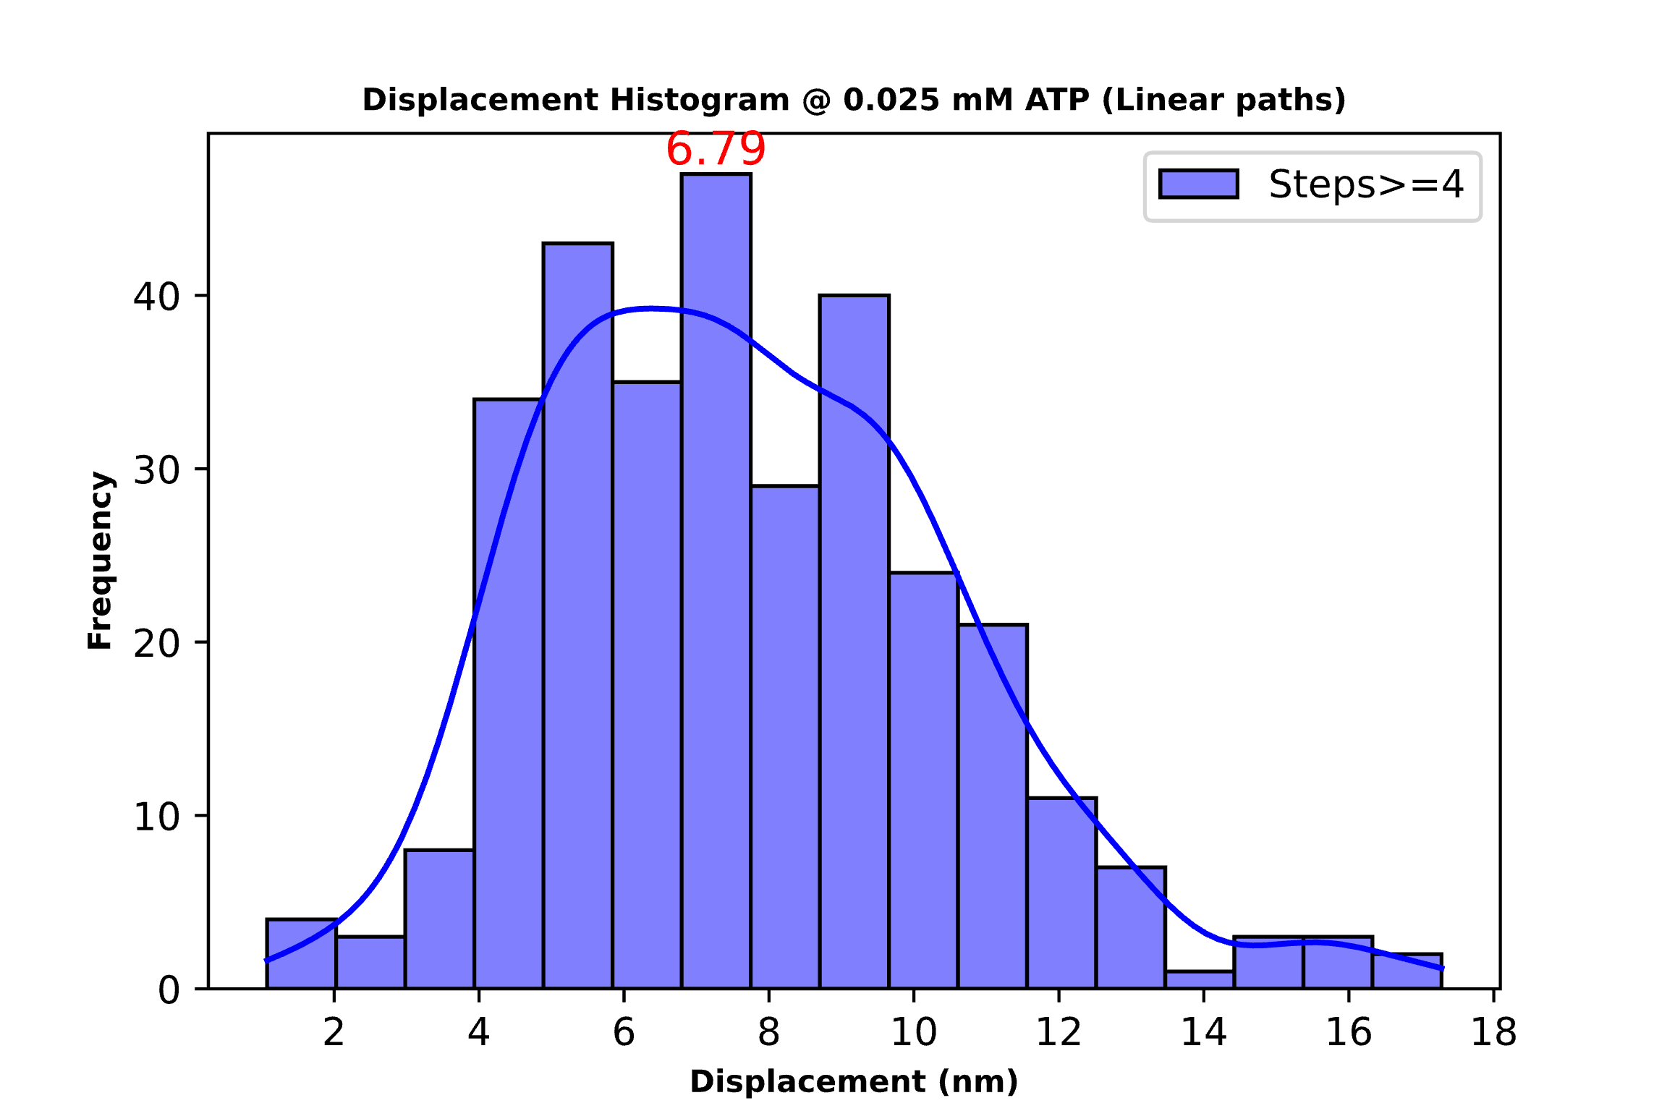
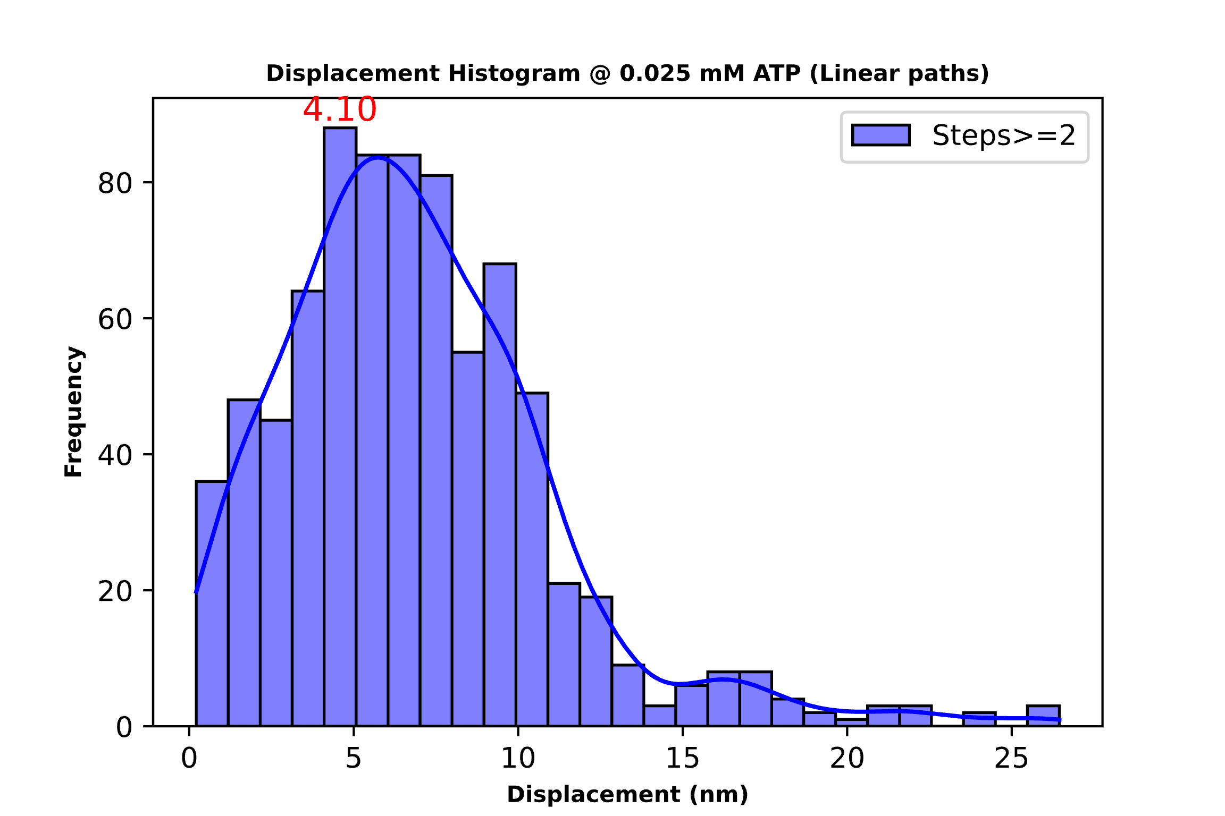
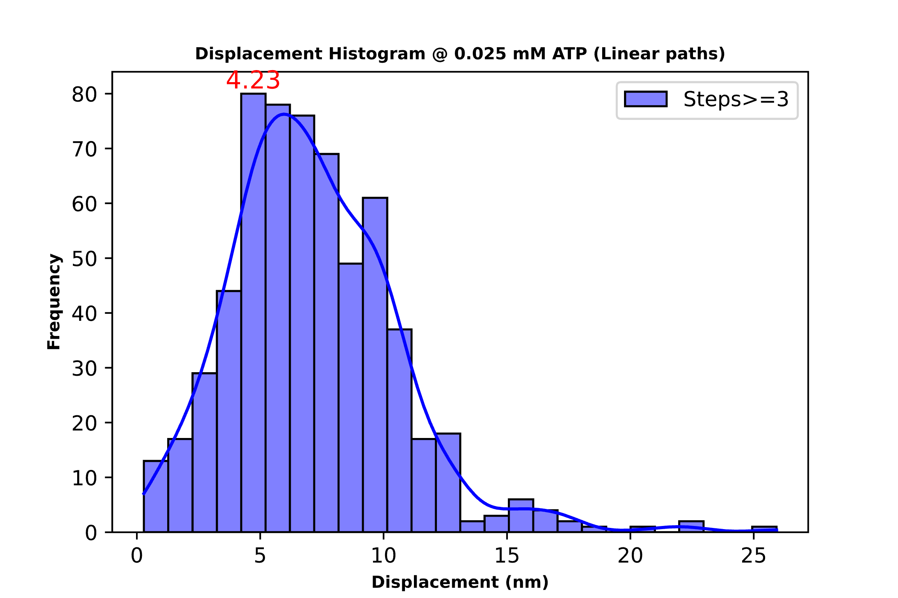
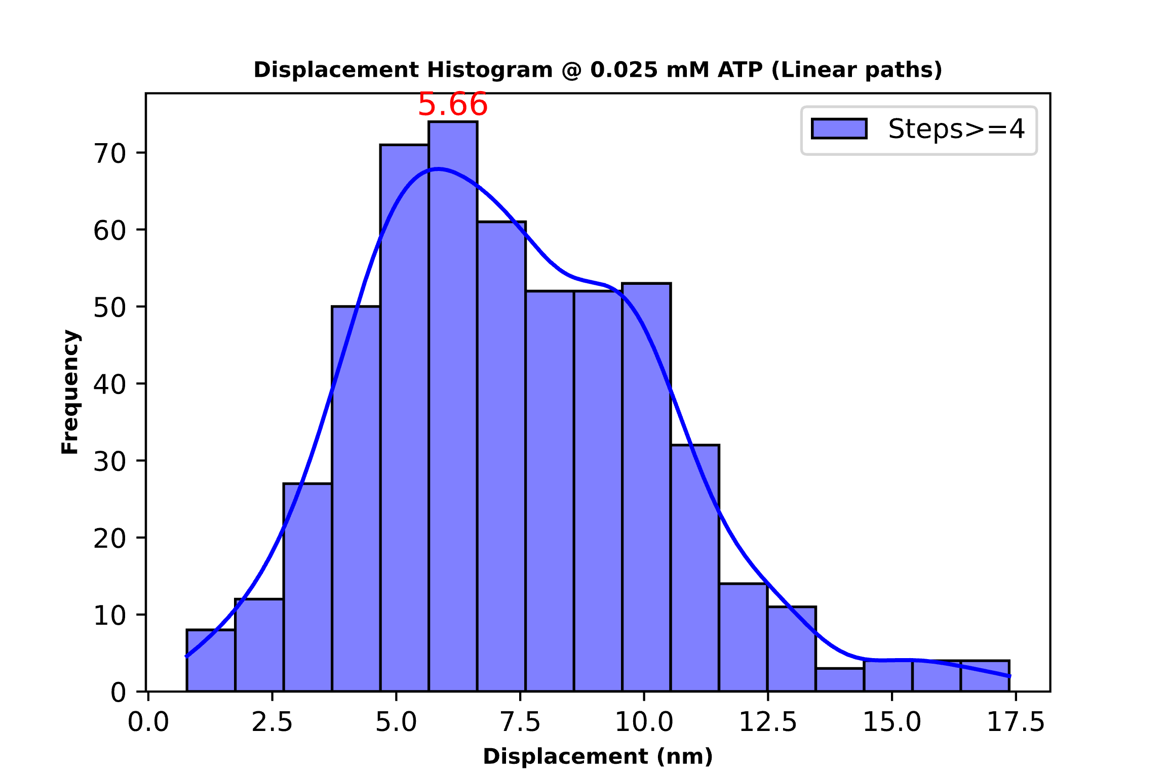
0.025 mM ATP Threshold 15 deg(Above) and 30 deg(Below)
Total steps: 315
Mean step size: 7.73
Total steps: 589
Mean step size: 7.19
Total steps: 405
Mean step size: 7.60
Total steps: 532
Mean step size: 7.34
Total steps: 794
Mean step size: 6.90
Total steps: 610
Mean step size: 7.15

Slide 11
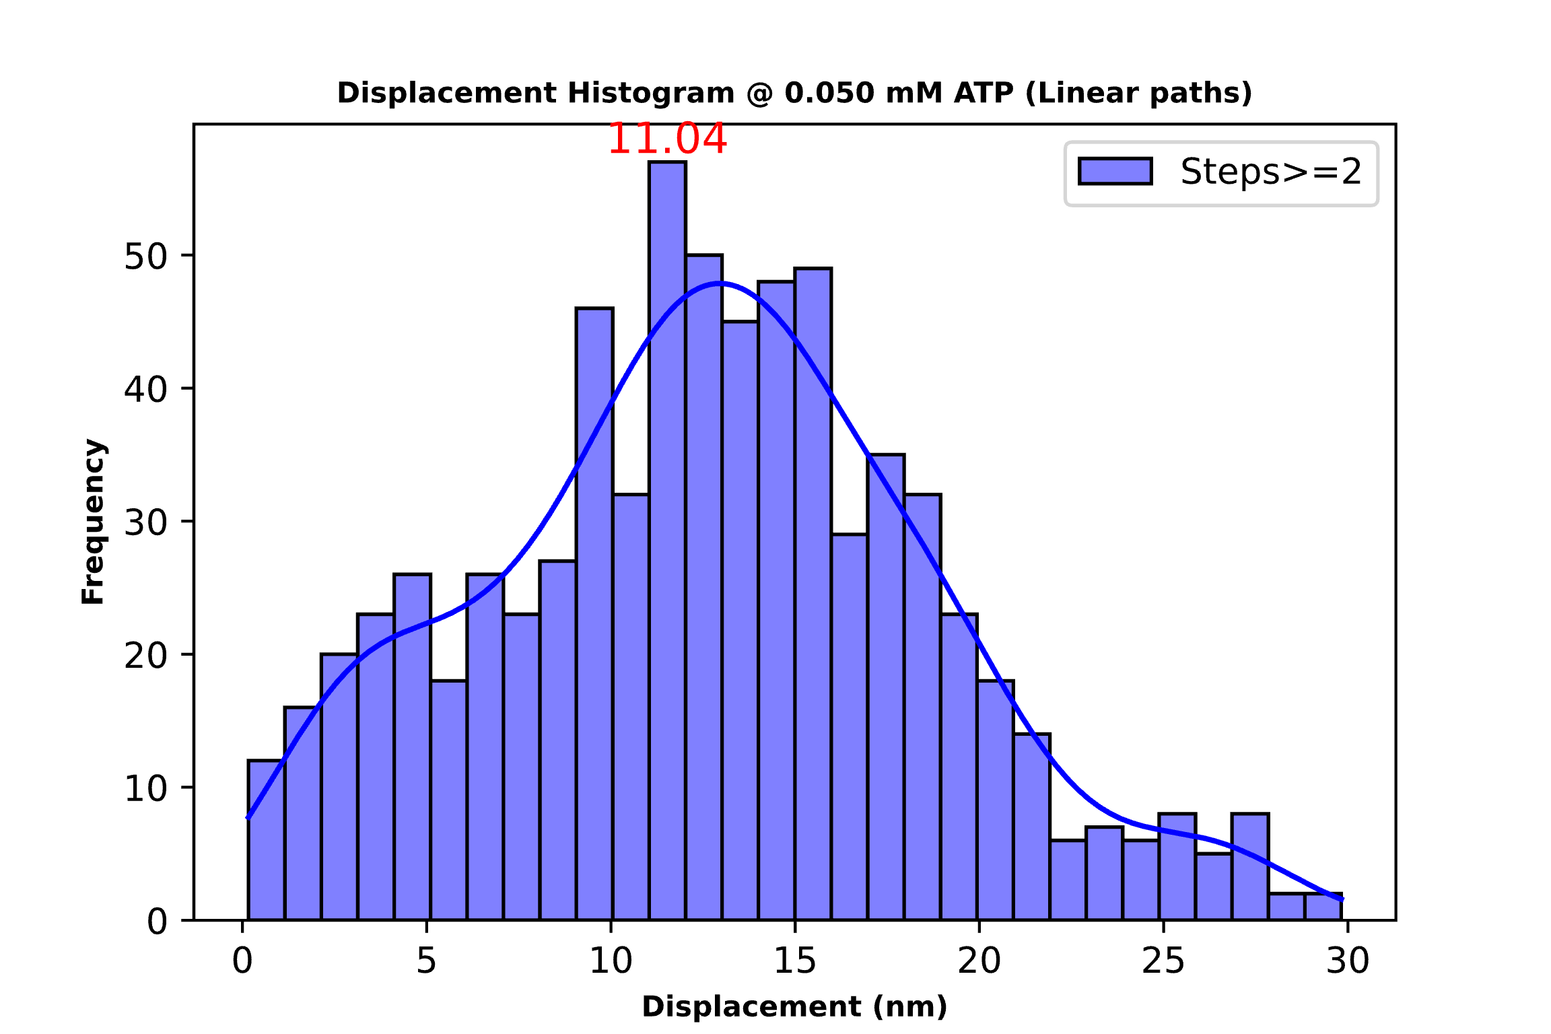
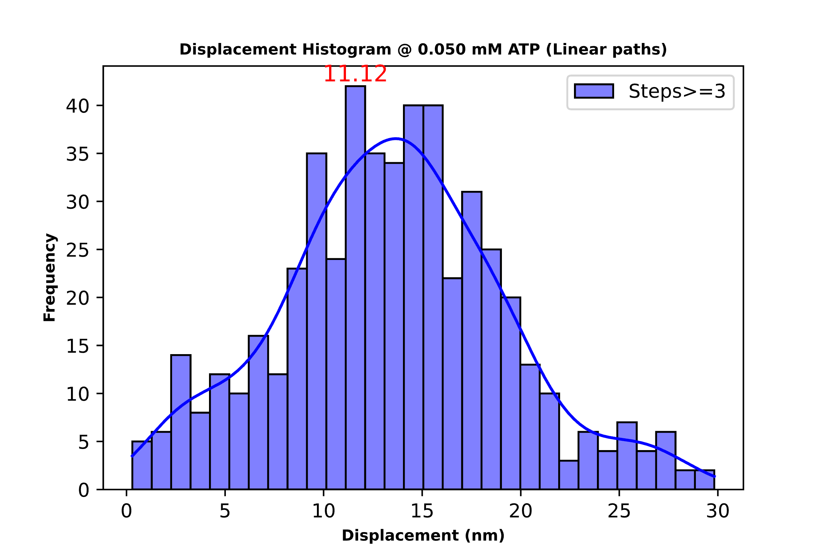
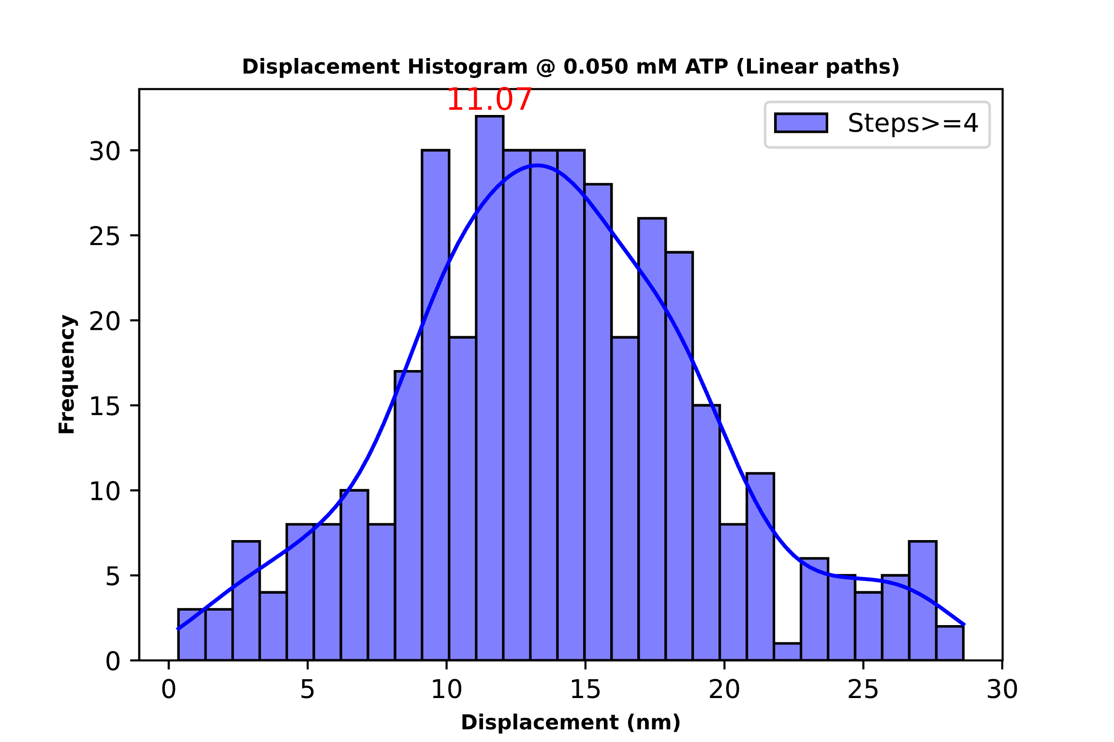
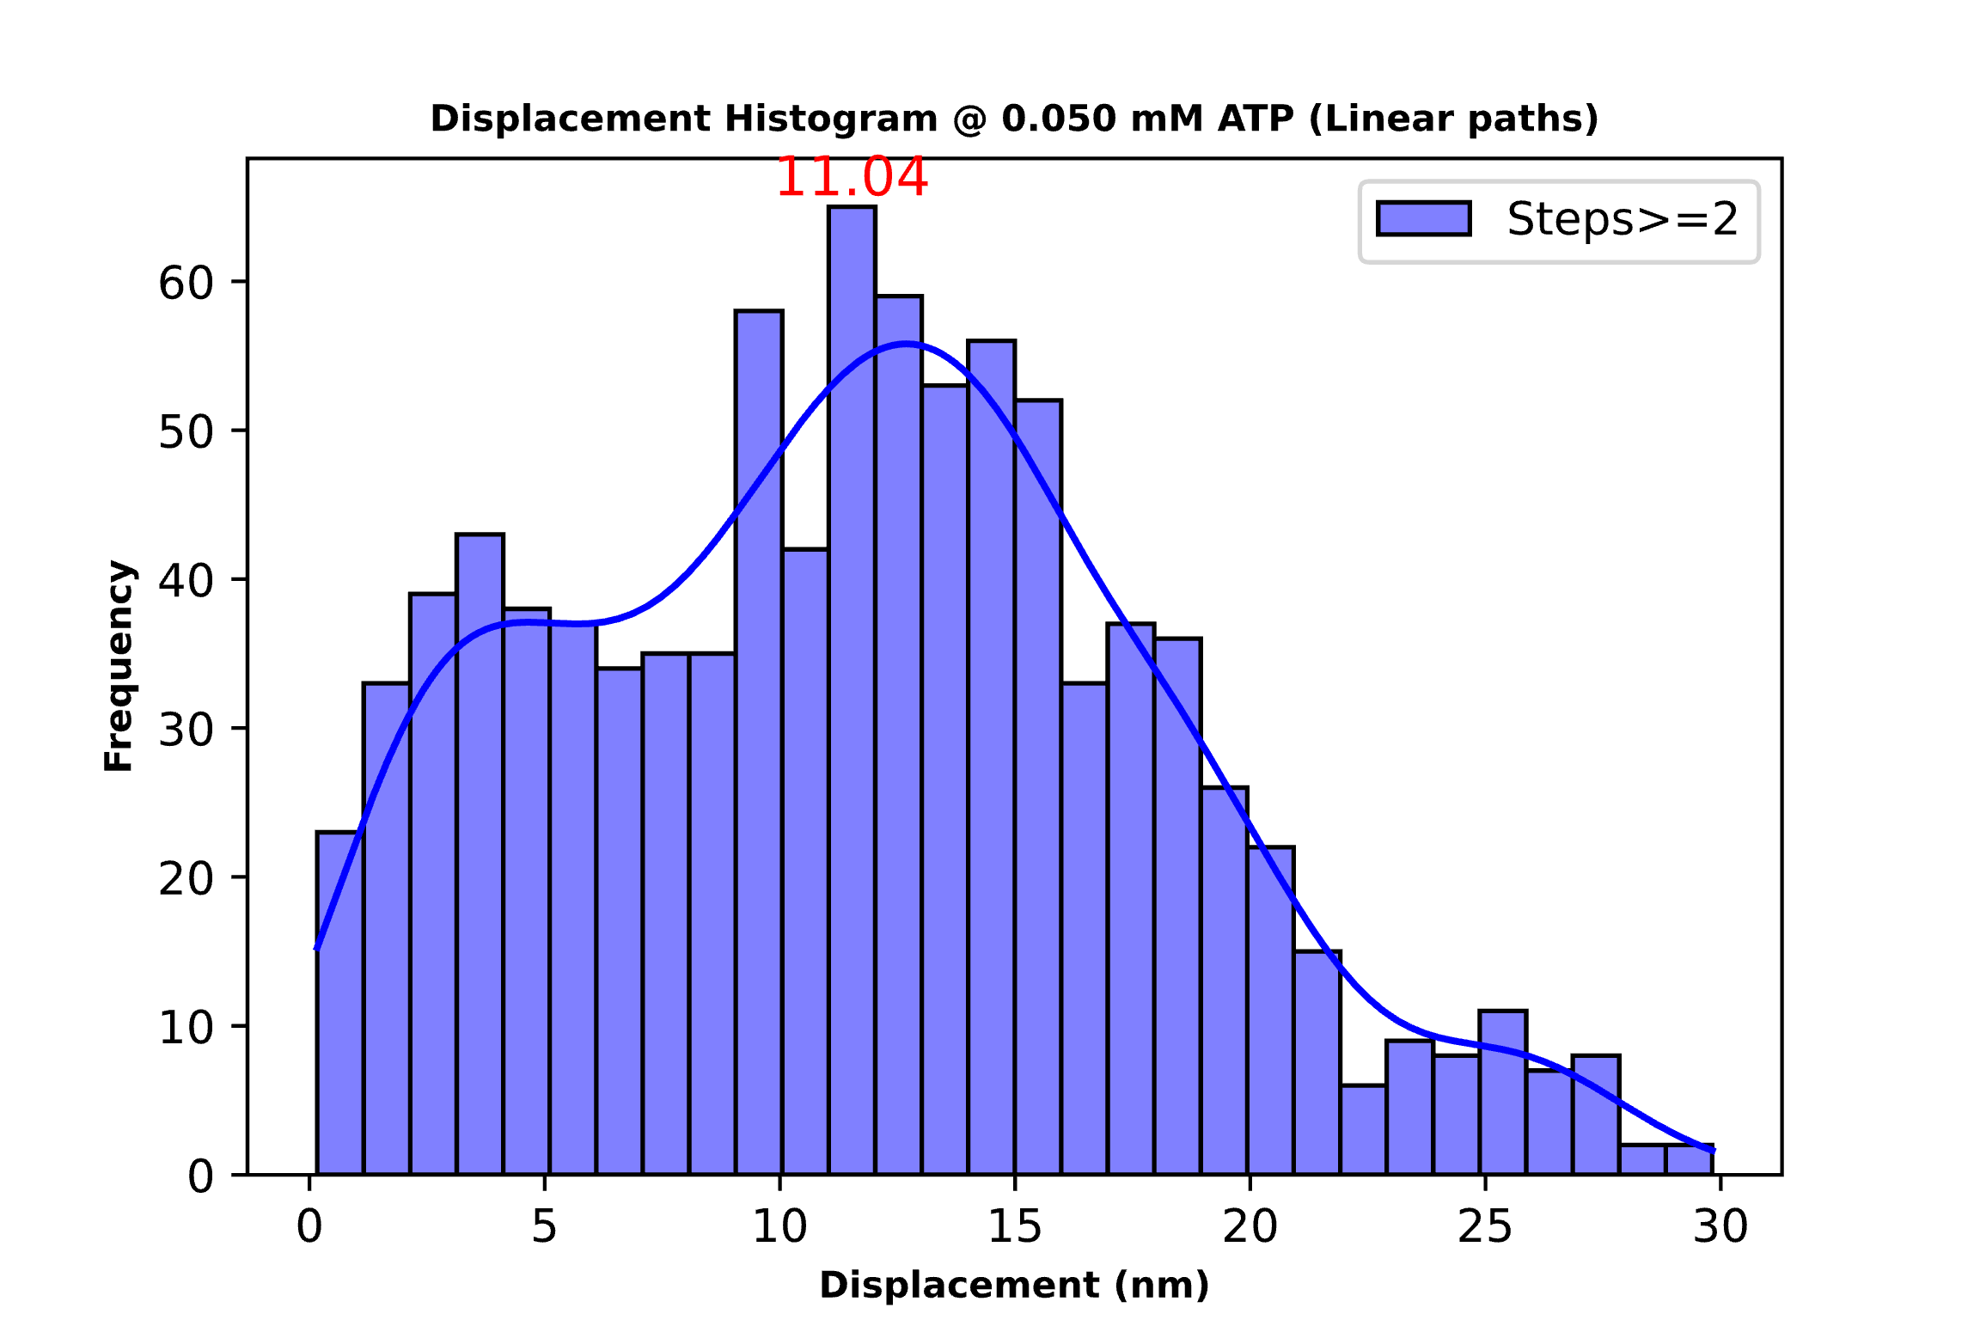
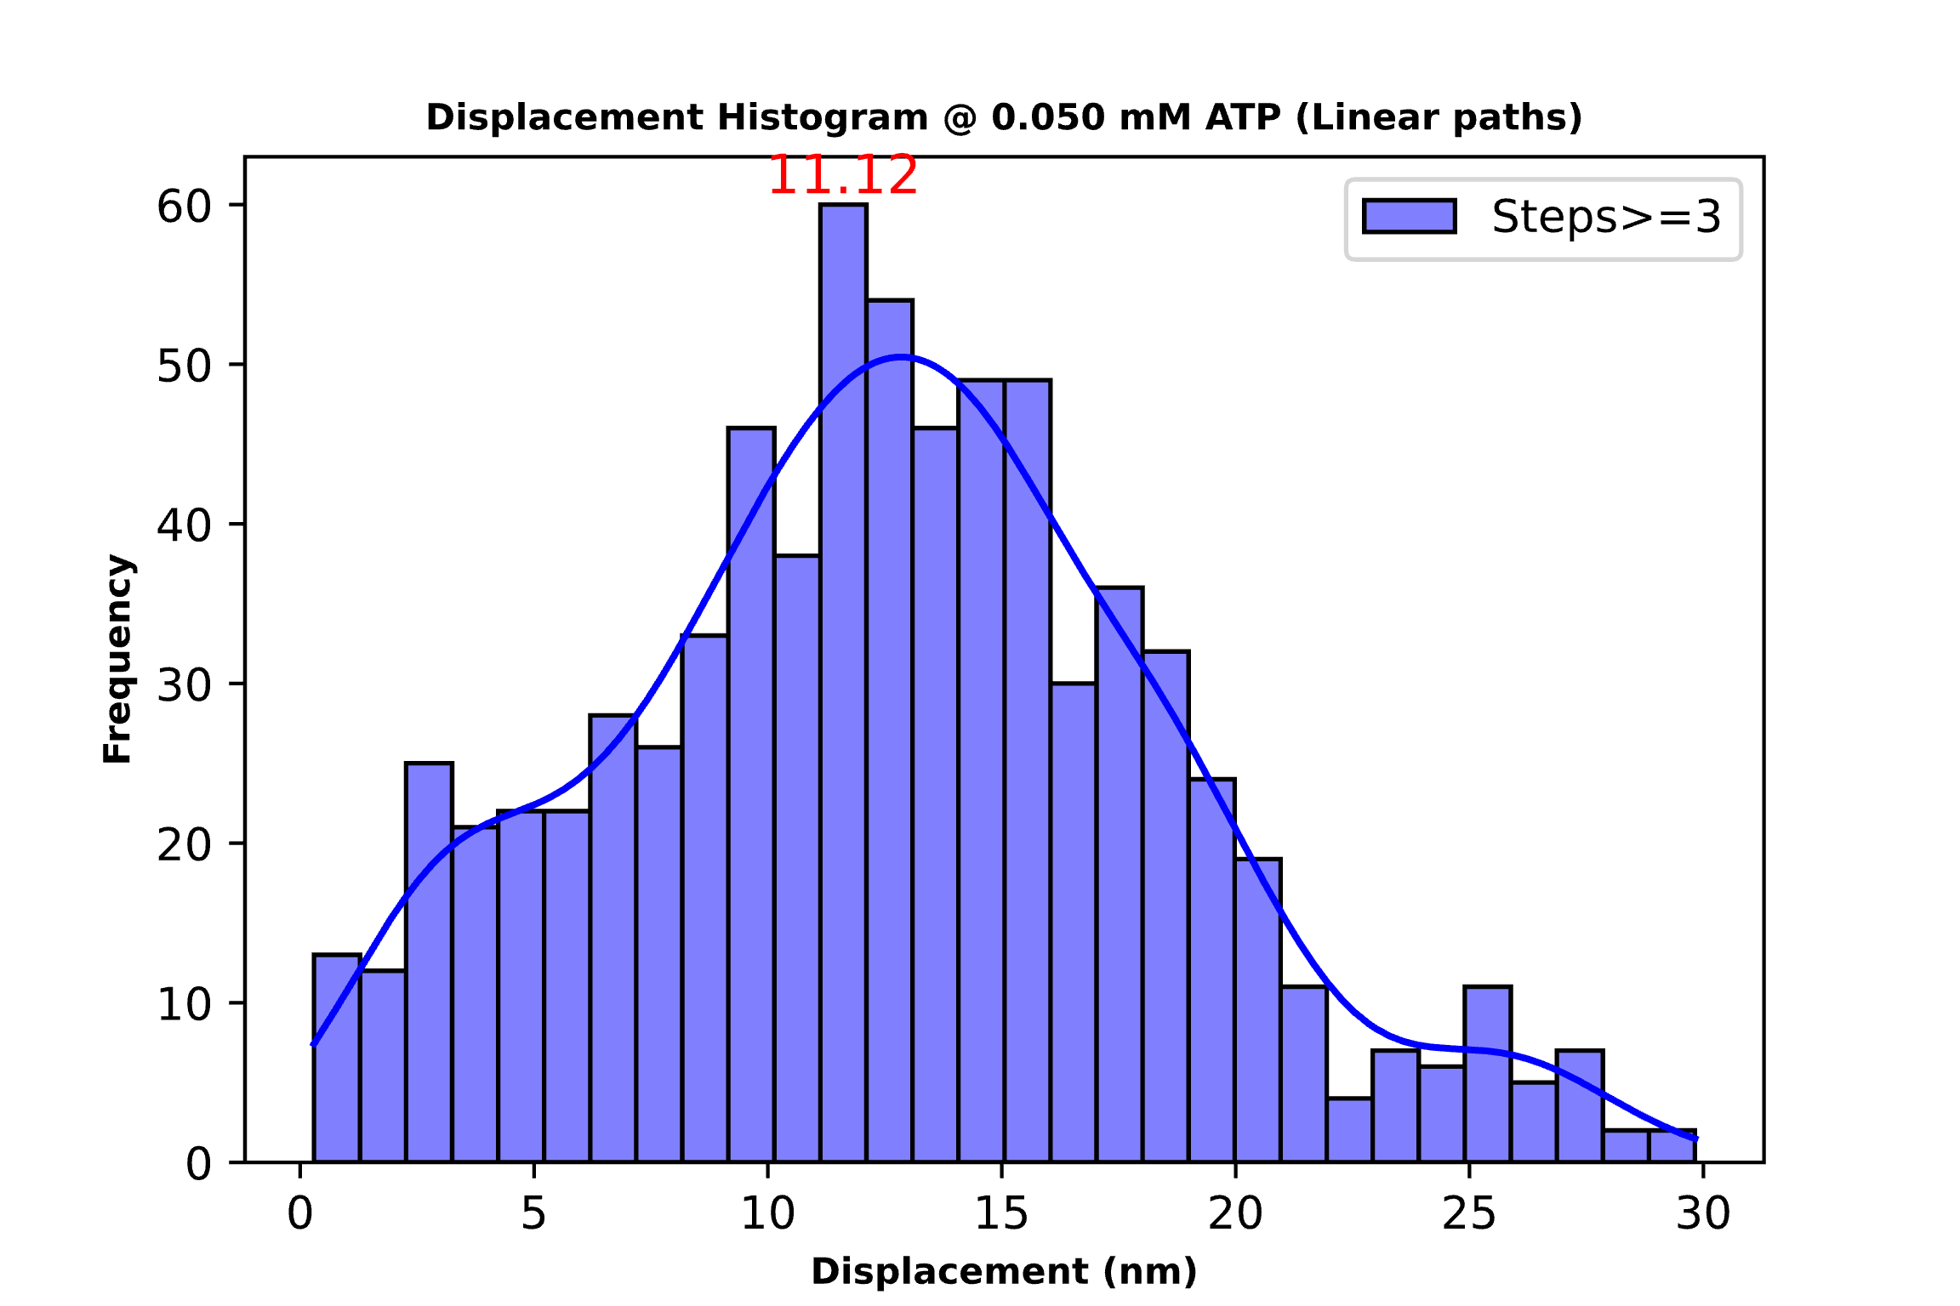
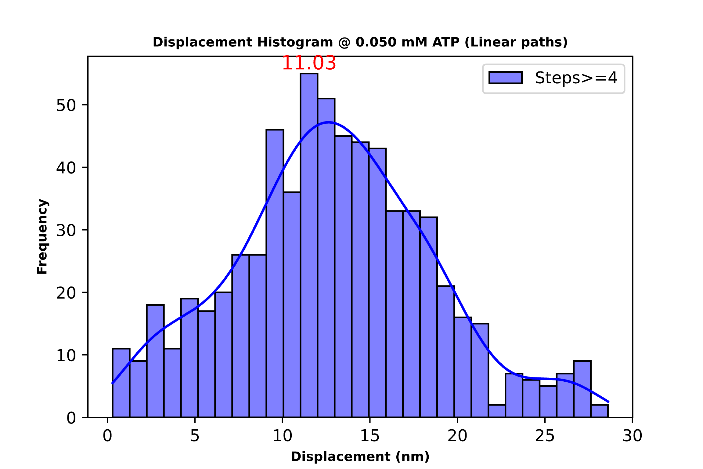
0.05 mM ATP Threshold 15 deg(Above) and 30 deg(Below)
Total steps: 713
Mean step size: 12.63
Total steps: 511
Mean step size: 13.49
Total steps: 400
Mean step size: 13.90
Total steps: 924
Mean step size: 11.67
Total steps: 740
Mean step size: 12.63
Total steps: 665
Mean step size: 12.89

Slide 12
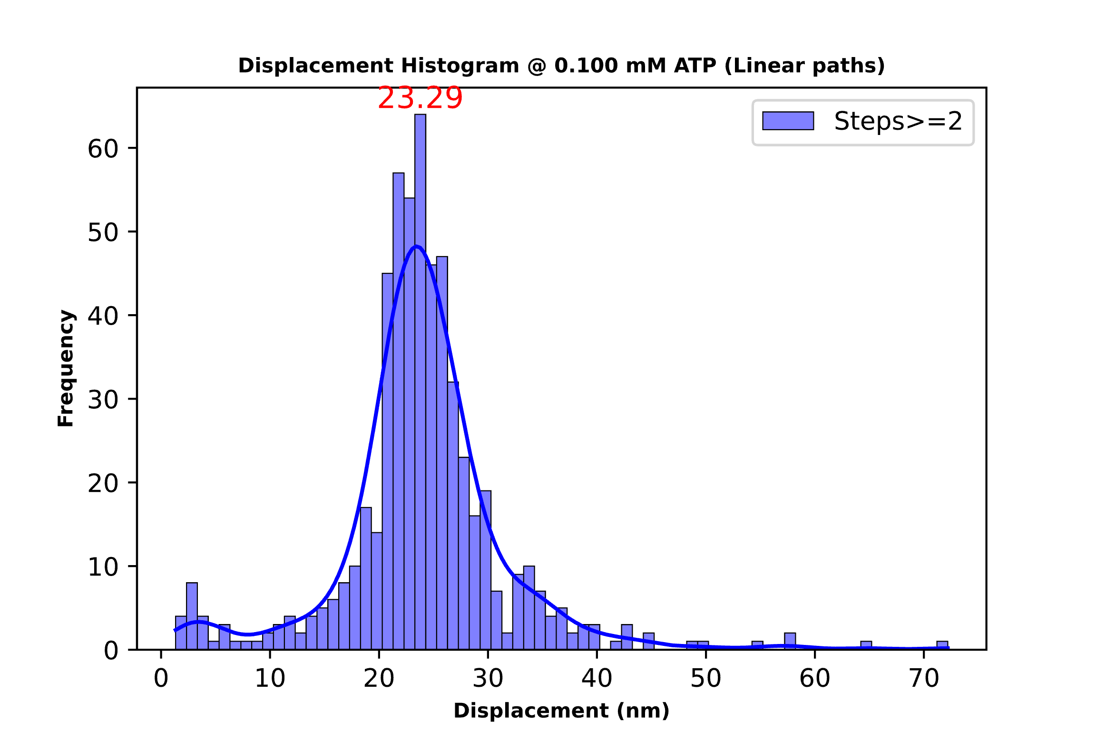
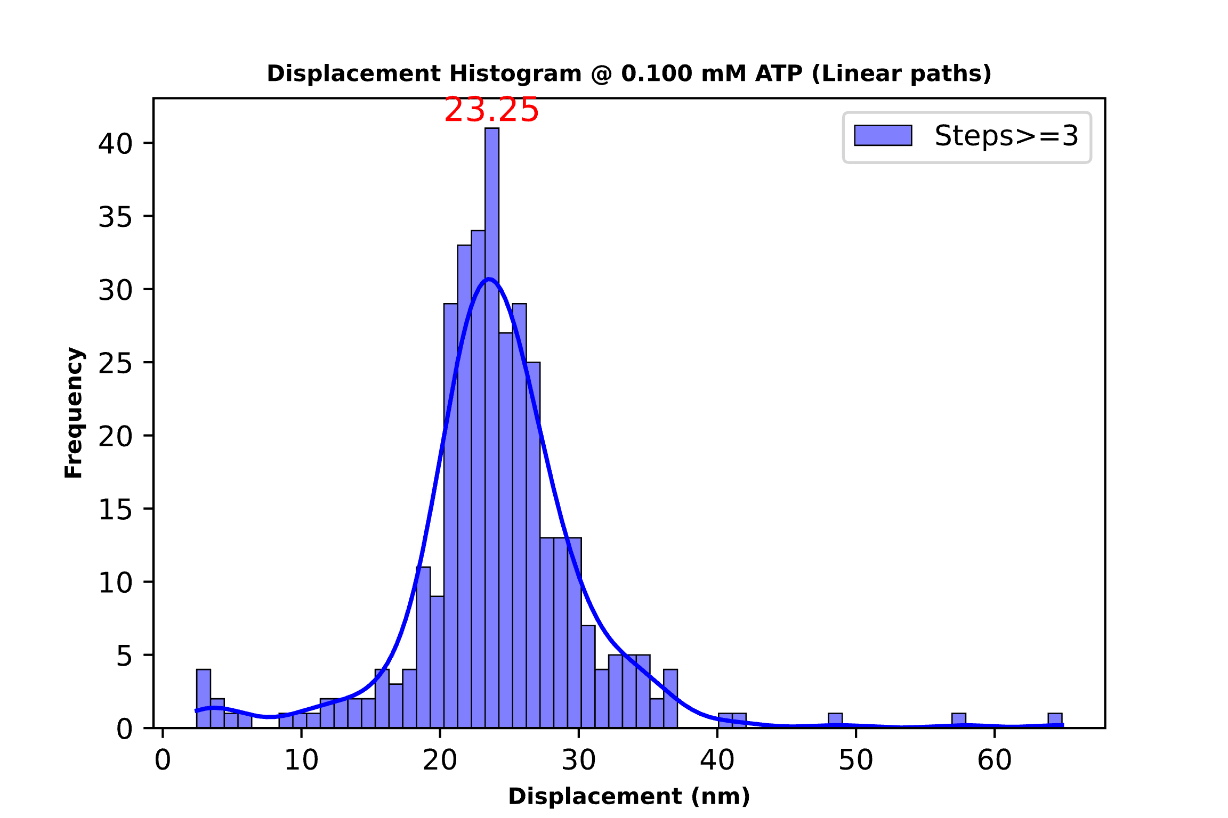
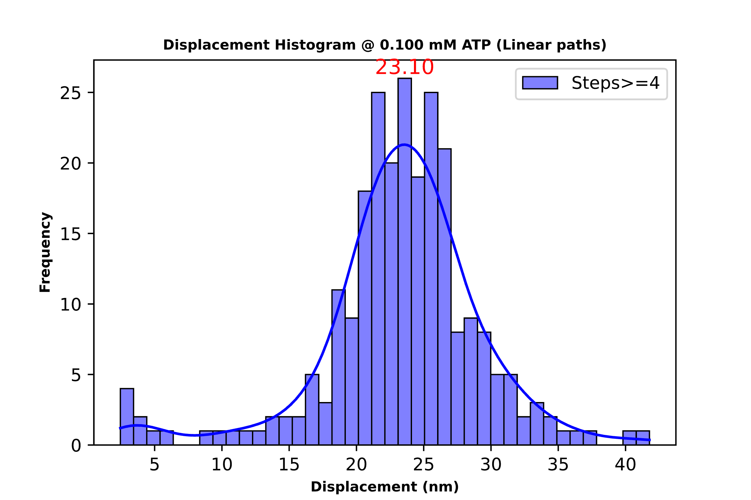
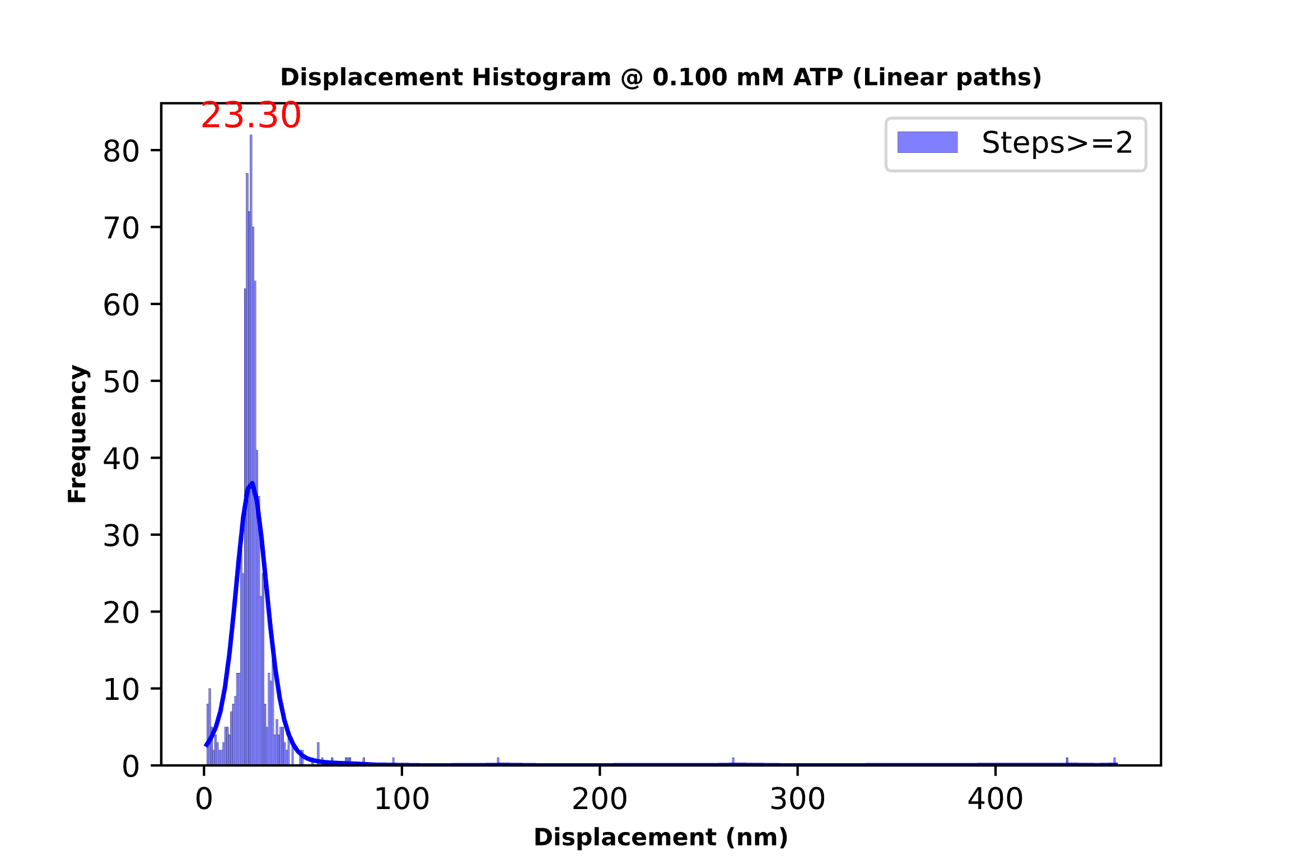
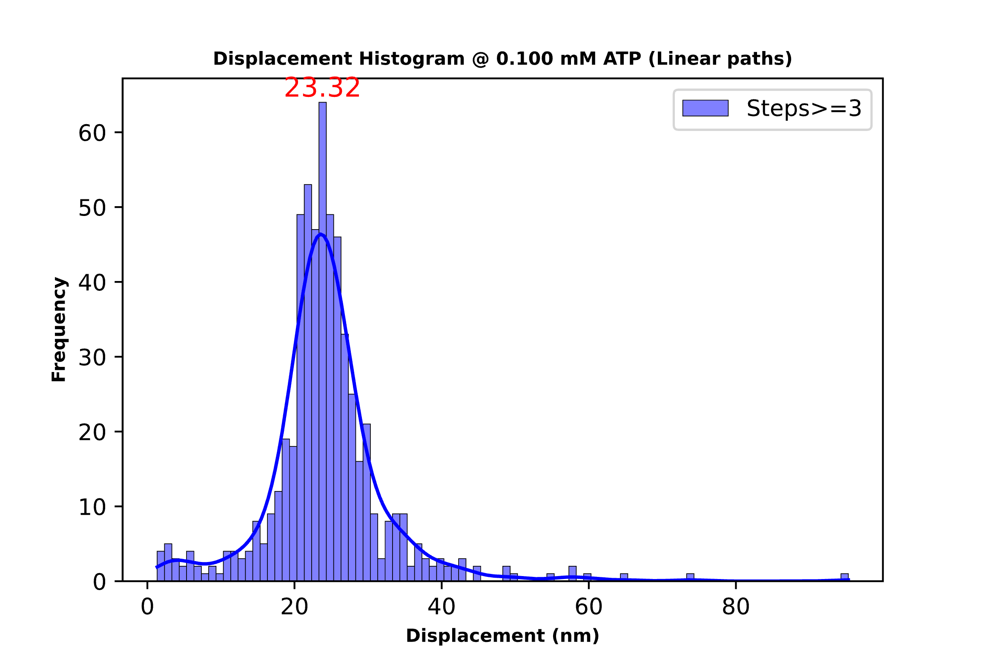
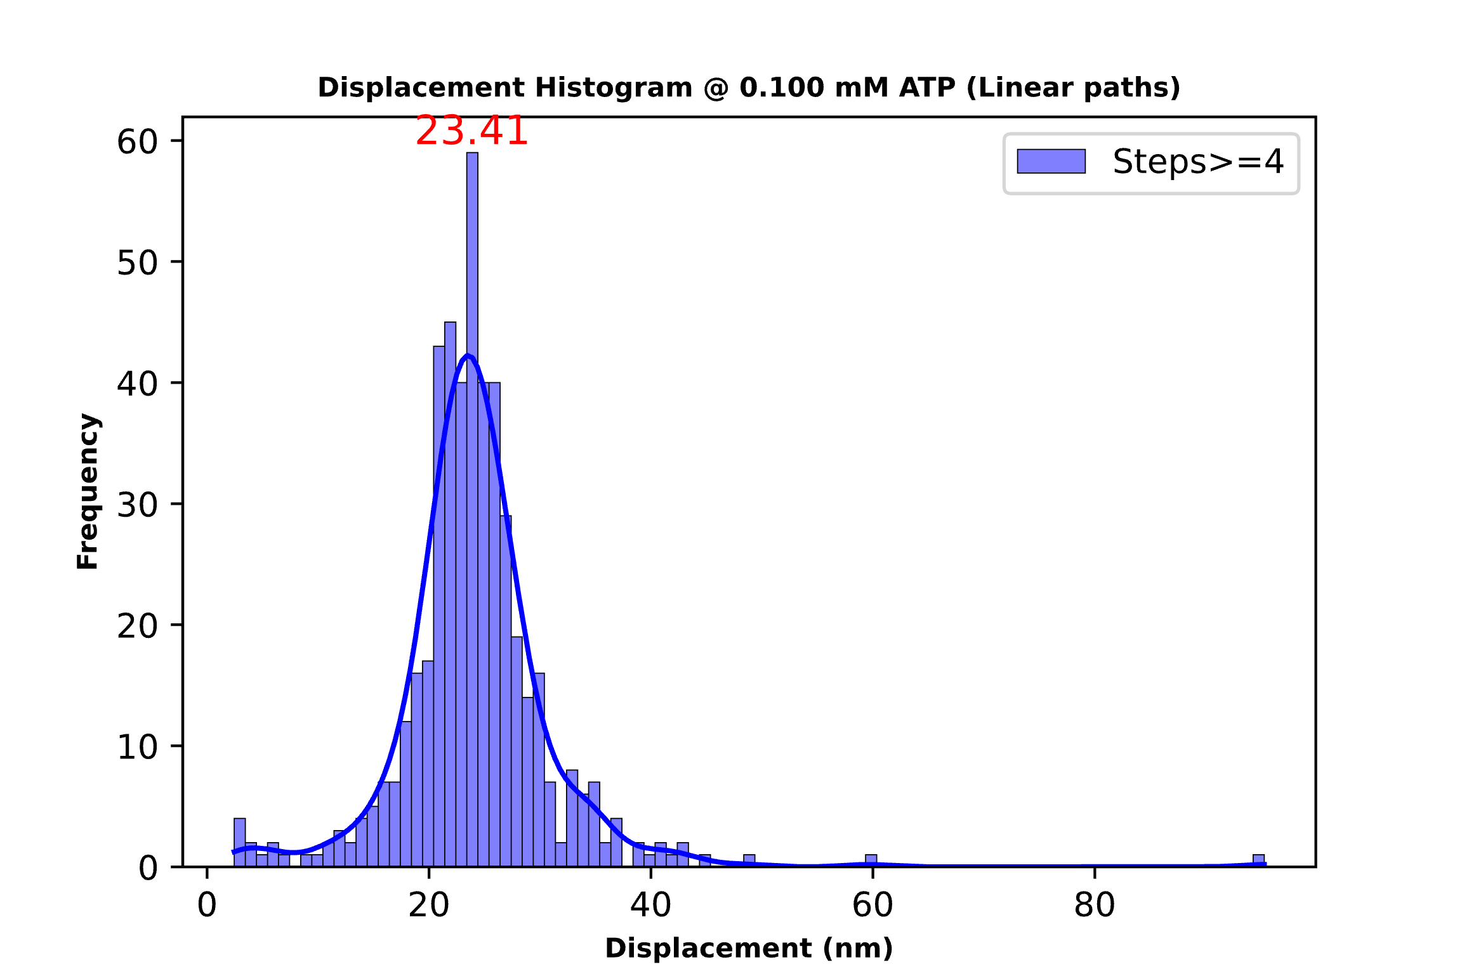
0.1 mM ATP Threshold 15 deg(Above) and 30 deg(Below)
Total steps: 566
Mean step size: 24.04
Total steps: 344
Mean step size: 24.18
Total steps: 248
Mean step size: 23.30
Total steps: 809
Mean step size: 25.79
Total steps: 585
Mean step size: 24.33
Total steps: 480
Mean step size: 23.98

Slide 13
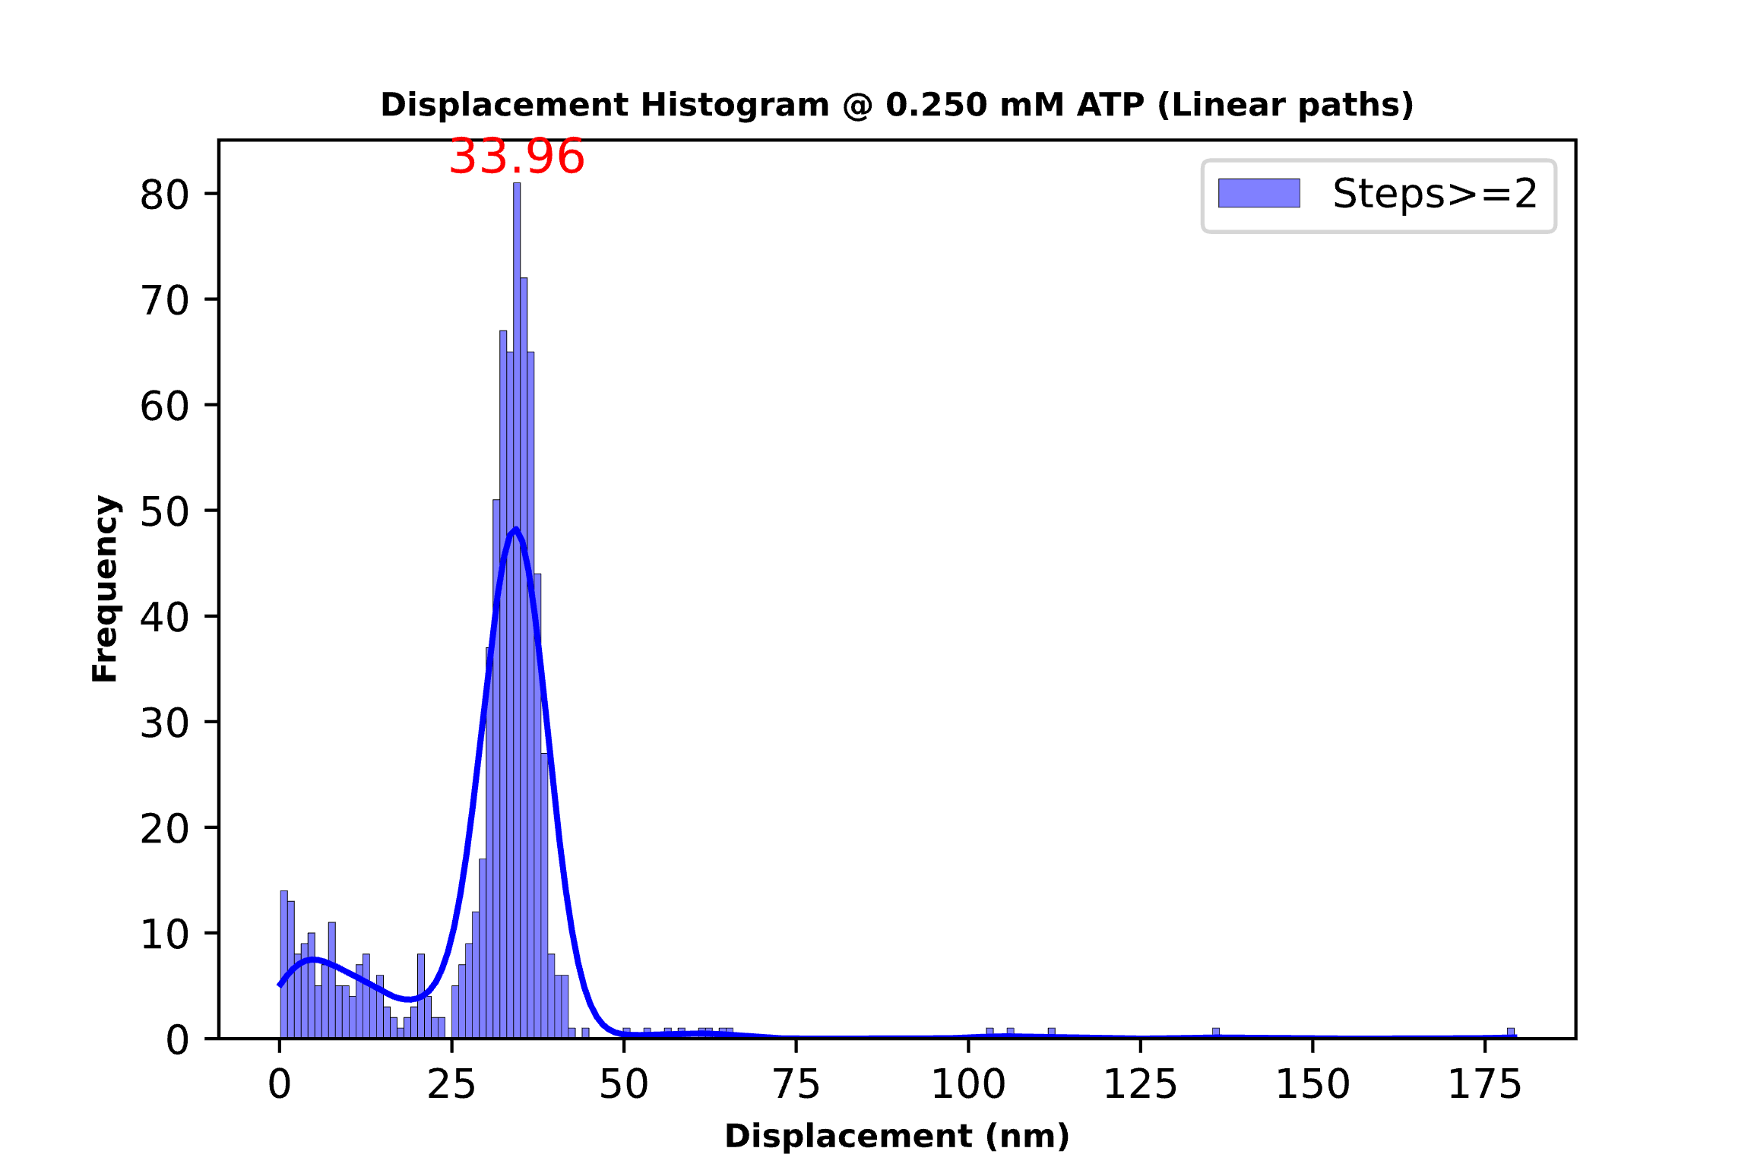
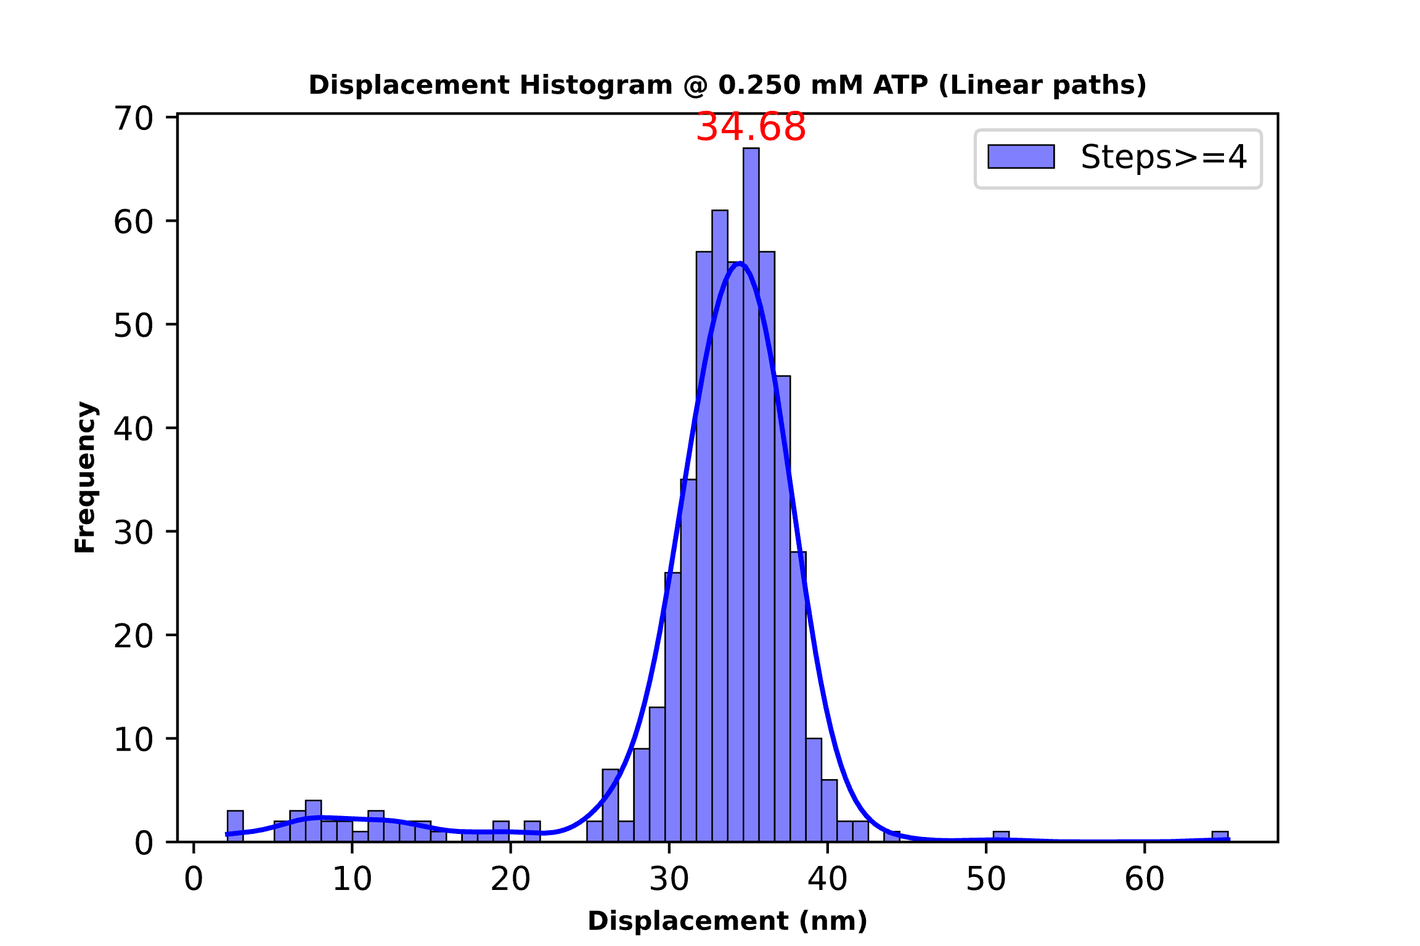
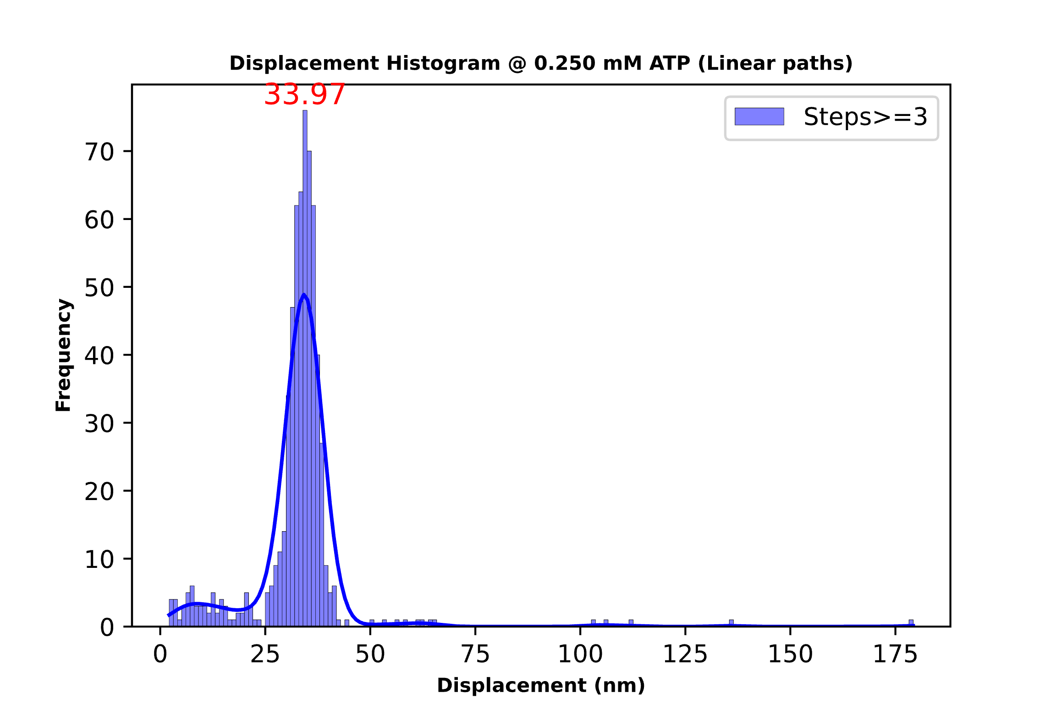
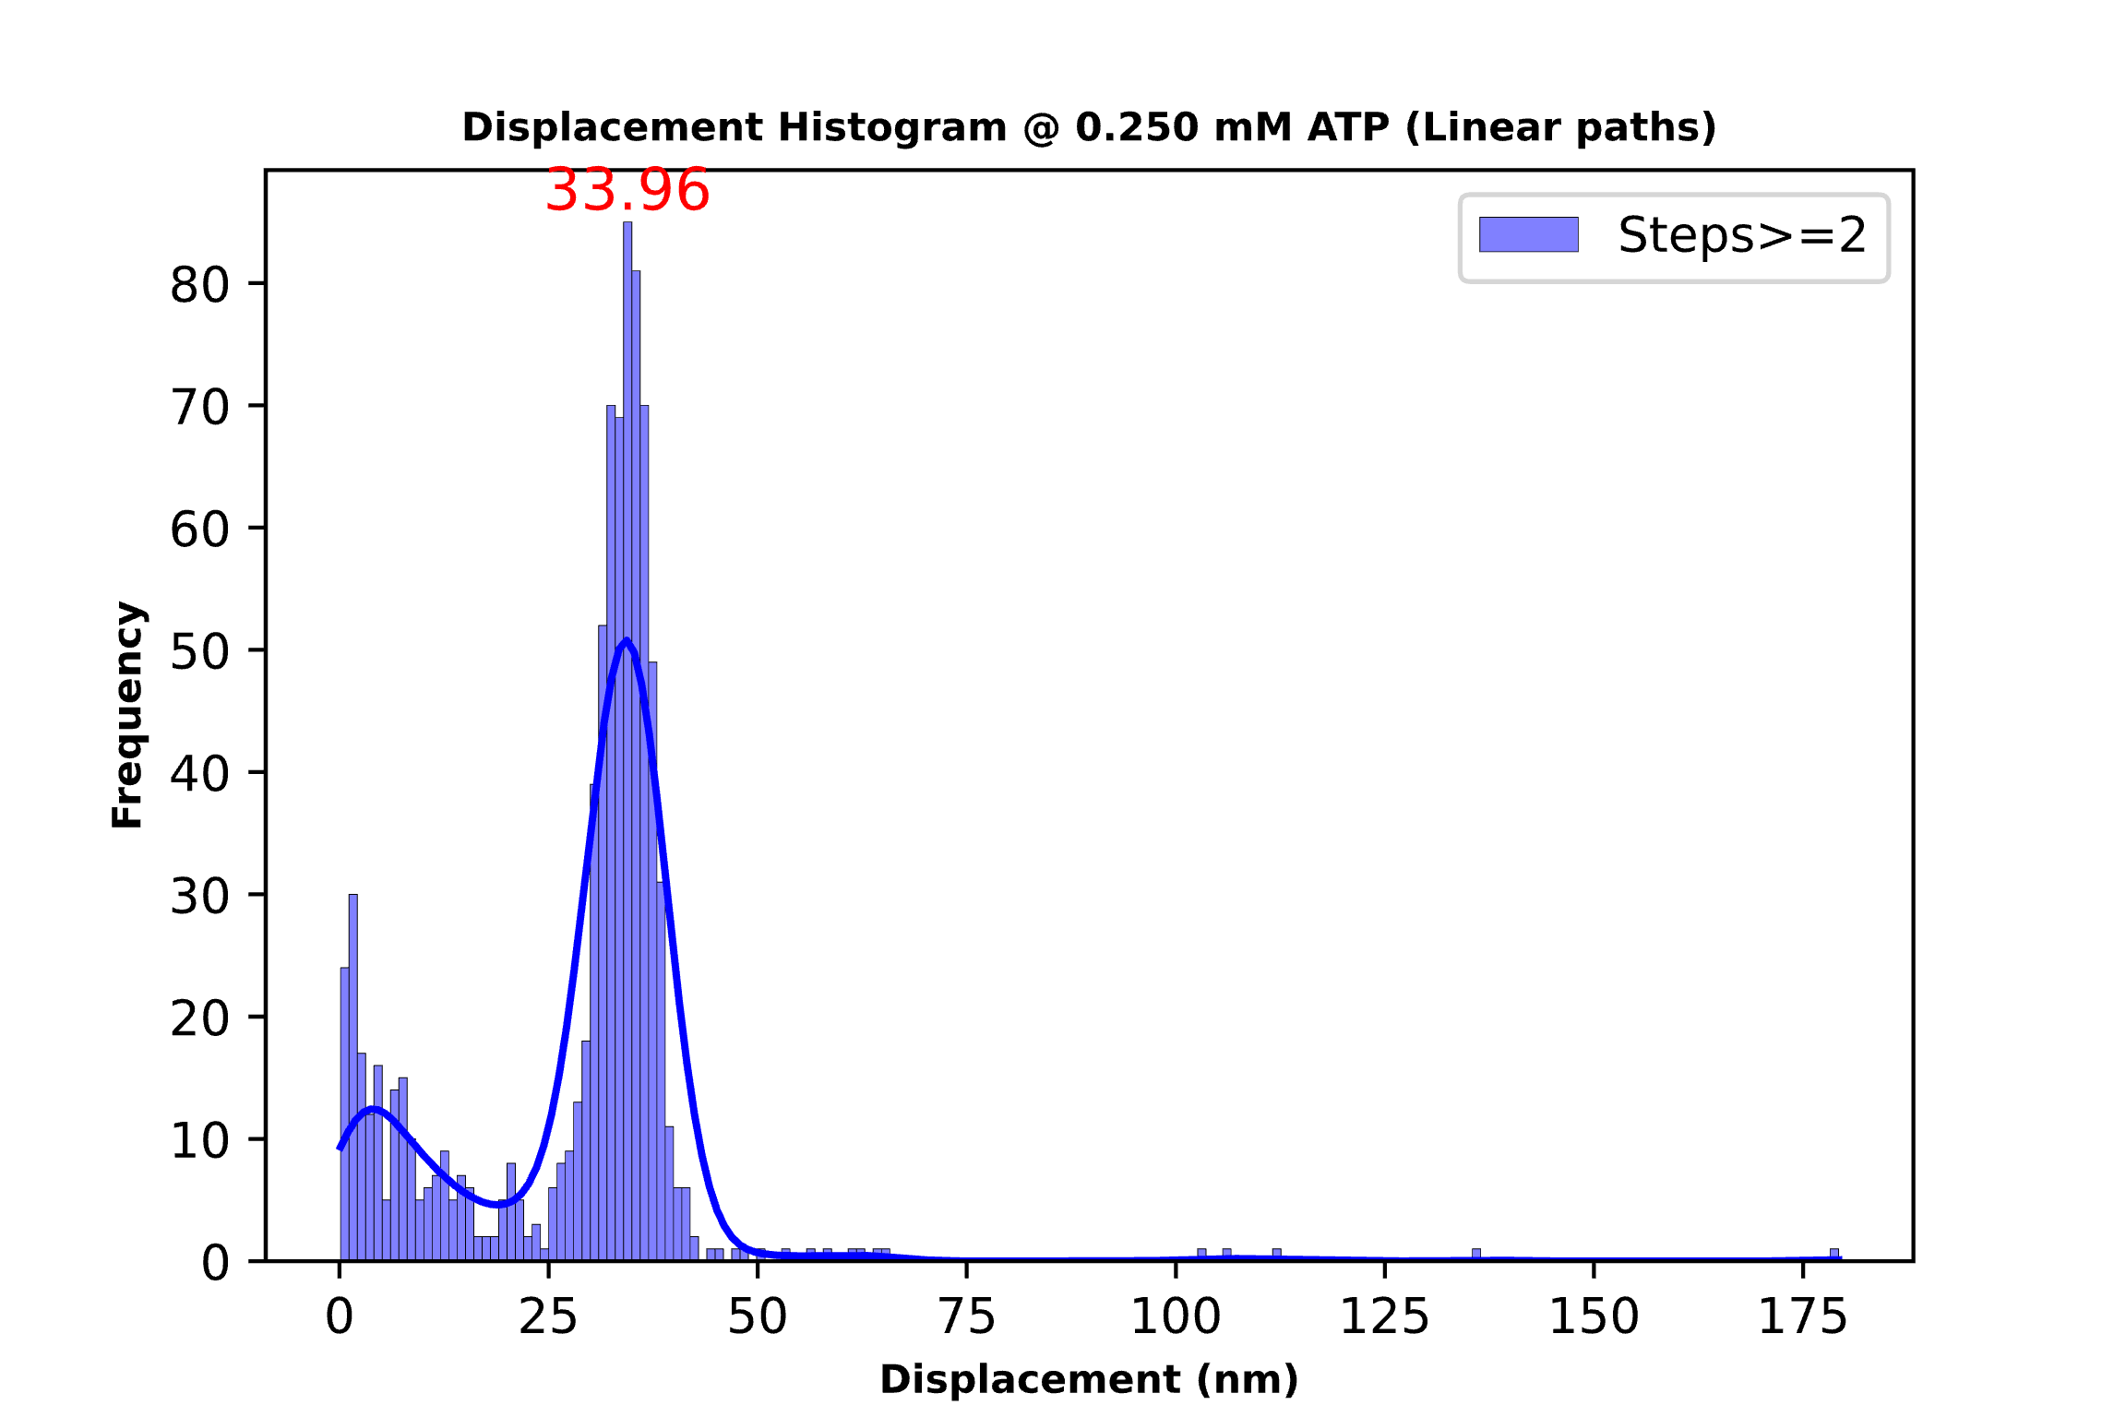
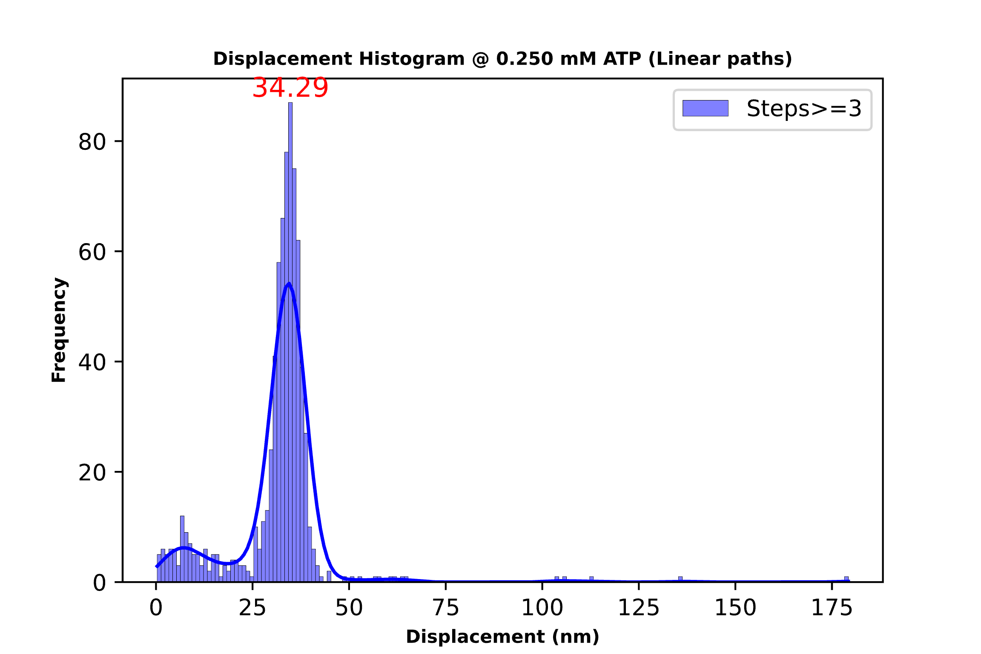

0.25 mM ATP Threshold 15 deg(Above) and 30 deg(Below)
Total steps: 626
Mean step size: 32.8
Total steps: 738
Mean step size: 30.05
Total steps: 521
Mean step size: 32.7
Total steps: 860
Mean step size: 27.49
Total steps: 746
Mean step size: 30.55
Total steps: 689
Mean step size: 31.51

Slide 14
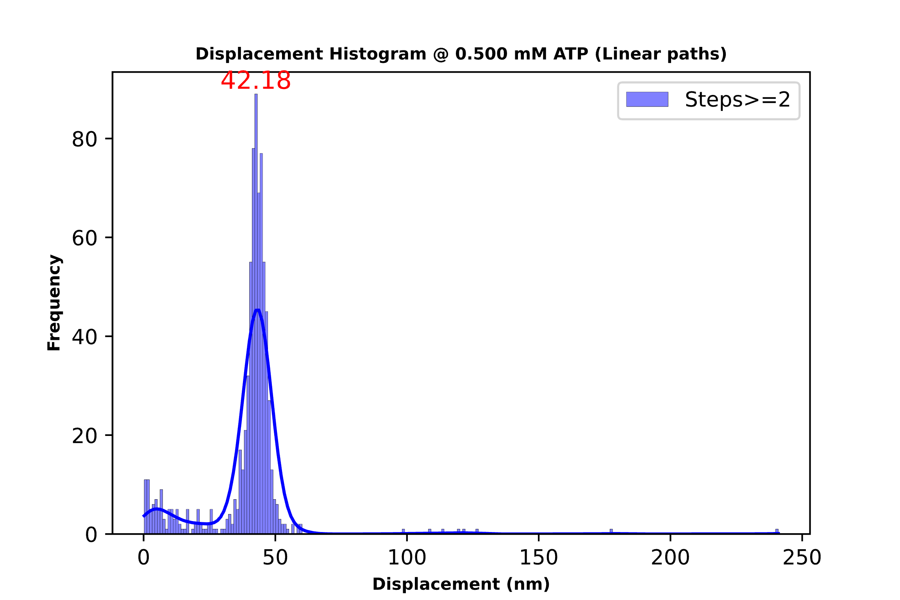
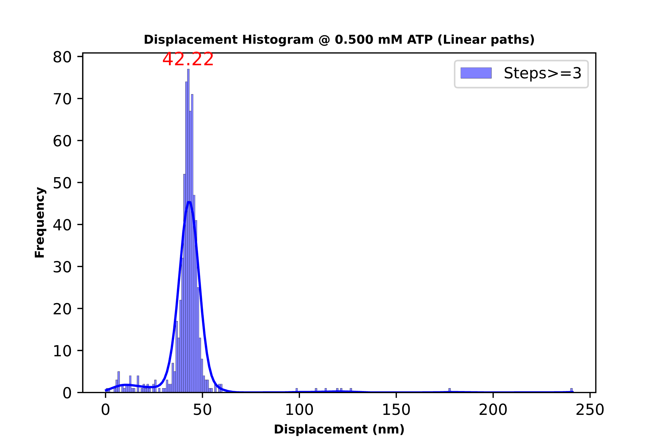
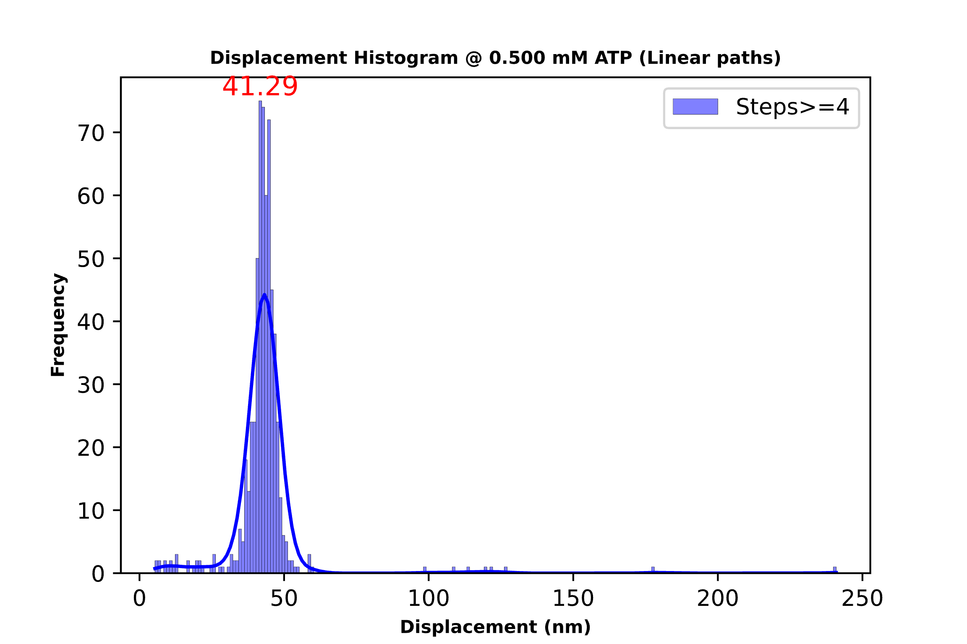
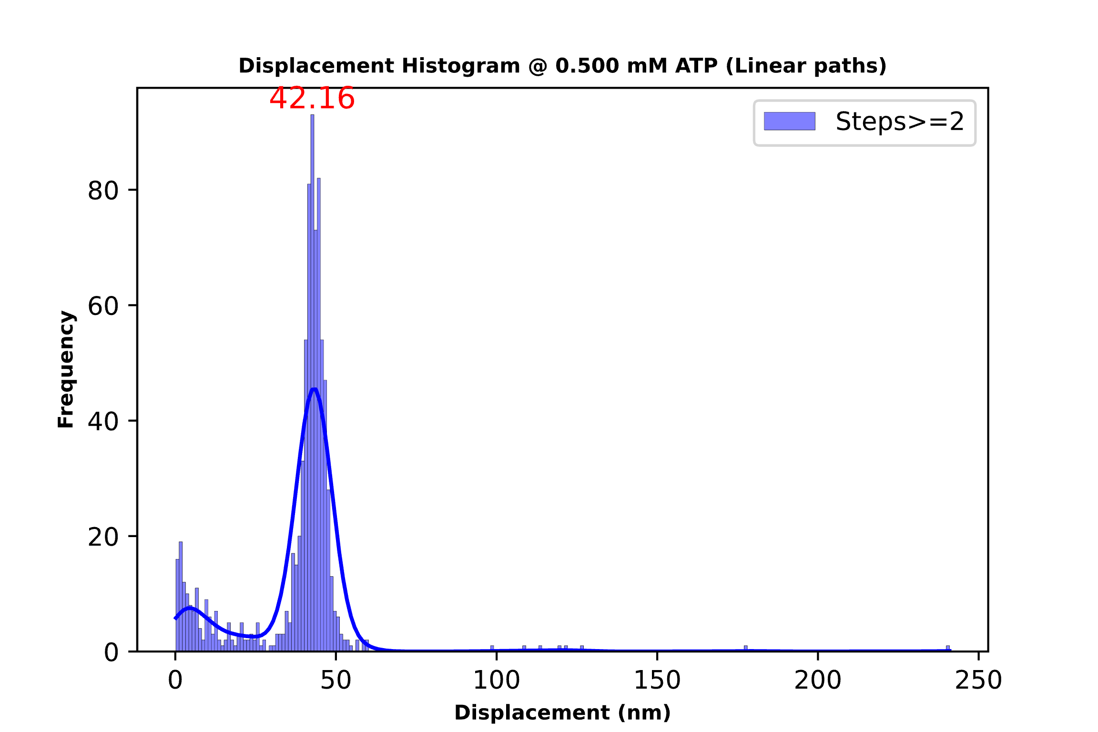


0.5 mM ATP Threshold 15 deg(Above) and 30 deg(Below)
Total steps: 755
Mean step size: 39.48
Total steps: 647
Mean step size: 42.48
Total steps: 605
Mean step size: 43.18
Total steps: 820
Mean step size: 37.75
Total steps: 756
Mean step size: 40.37
Total steps: 717
Mean step size: 41.50

Slide 15






2.0 mM ATP Threshold 15 deg(Above) and 30 deg(Below)
Total steps: 568
Mean step size: 45.8
Total steps: 516
Mean step size: 48.25
Total steps: 483
Mean step size: 50.02
Total steps: 633
Mean step size: 42.77
Total steps: 565
Mean step size: 46.42
Total steps: 526
Mean step size: 48.15

Slide 16
Interesting Analysis From Earlier Histograms
The table shows the mean step sizes at different ATP conc and different thresholds
From earlier histograms, the minimum step size is around 6 nm(varying b/w 5 to 7).
Both 0.001 and 0.025 are very low conc, may be the reason for having same step size
It's interesting to note that the step sizes at higher concentrations are multiple of that observed at the lowest ATP
Conc.(mM ATP) | Mean Step Size(steps>=4 & Threshold-15 deg)(nm) | Mean Step Size(steps>=4 & Threshold-30 deg)(nm)
0.001 | 7.35 | 7.32
0.025 | 7.73 | 7.34
0.05 | 13.9 | 12.89
0.1 | 23.3 | 23.98
0.25 | 32.7 | 31.51
0.5 | 43.18 | 41.5
2.0 | 50.02 | 48.15
Notes:
SO for first two conc the step size remains same means the increase in conc doesn’t mean there will be increase in the step size. This give some idea about the nature of the step sizes taken by the particle. Both the conc are very low so the step size remains same(which is the minimum for the given actin myosin system). As there is enough conc of ATP , the step size increases in fact it doubles(2*minimum step)
This phenomenon is similar to what observed in electrons moving from lower to higher energy states, electron won't move to next state until a specific threshold energy is received

Slide 17
Histograms For Pooled Data (with 15/30 deg Threshold Angle)
The steps for all concentrations are merged in one data frame
Plotted these steps in a histogram to analyze the steps by the actin filament in the experiment

Slide 18






Pooled Data Histogram(All conc.) Threshold of 15 deg(Above) & 30 deg(Below)
Total steps: 4750
Total steps: 3716
Total steps: 2999
Total steps: 5892
Total steps: 4887
Total steps: 4390

Slide 19
Multi Gaussian Fit on the histograms(Pooled data) (For min. Steps 3 and threshold of 15&30 deg)
In the histogram for pooled data there are multiple peaks (which correspond to different ATP conc)
A clustering algorithm is used for finding these peaks
Used Gaussian Mixture Model (GMM) for fitting the multiple gaussians
Why Gaussian? - Actin-myosin interaction is a Natural Phenomenon
For finding the optimal number peaks present in the data:
Akaike Information Criterion (AIC) and Bayesian Information Criterion (BIC)
BIC is generally better for models where interpretation and understanding the underlying process are more important.
Notes:
Gaussian – Most of the natural phenomenon tend to follow the gaussian distribution.
Akaike Information Criterion (AIC) and Bayesian Information Criterion (BIC): These criteria provide a measure of the model quality by balancing the model's complexity against how well it fits the data. Lower values of AIC and BIC indicate a better model. We can fit GMMs with varying numbers of components and choose the one with the lowest AIC or BIC.

Slide 20


Optimal Number of Peaks
For both 15(above) and 30(below) degree threshold:
The minimum BIC score occur at n_component = 6
Peaks in the underlying data are 6

Slide 21


Peaks Observed (15 deg Above and 30 deg Below)
There are 6 peaks observed in both the multi gaussian fits
These peaks are in accordance with our earlier analysis for each concentration separately.
The initial conclusion is also observed:
The smallest step size is approx. 6nm
Other higher step sizes seem to be the integral multiple of 6 (12, 24, 36, 42, 54)
Notes:
Explanation for obtaining 6 peaks – So we had 7 different conc. As we have already observed that at two of conc 0.001 and 0.025 mM ATP the mean step sizes are similar. These two peaks get merged and left 5 concentrations have their own individual peaks . So in total 6 peaks , … which we are seeing as the result of above clustering

Slide 22
Scatter Plots for Pooled Data (15&30 degrees)
Below analysis is to understand the relation between the simultaneous steps of the particle in a linear path(d1, d2, d3, d4)
And to understand how the cluster center(mean step size) vary
Analysis is done for 15&30 degree for pooled data only (done for individual conc too, not shown here)

Slide 23


Slide 24


Slide 25

Here the GMM fitting is done to find the clusters in the plot
There are 6 clusters found with centers as mentioned
The centers are lying on the line x = y which means d1 = d2
The same is observed for d1 vs d3 & d1 vs d4(plot shown on next slide)
It can be said that the centers represent the mean step size; means the steps sizes vary linearly
Notes:
The centres are representing the mean step size as it is mean of cluster. The centres are lying in linear line which mean the step size vary linearly as discussed in earlier slides. It seems to be the integral multiple of of some constant

Slide 26


d1 vs d3 (30 deg threshold)
d1 vs d4 (30 deg threshold)

Slide 27
Conclusions
The obtained results for the mean step size at various ATP concentrations were in accordance with those reported in the literature.
The step size increases with the increasing ATP concentration
The step sizes have a relation among each other which is: The step sizes may have a quantized nature as observed in the analysis. The step size at higher concentrations is either integral multiple of smallest step size or mixture of other smaller steps (if there are multiple types of systems of Actin-Myosin having a minimum each).
There is possibility of a system of Actin Myosin having two or more kind of steps naturally and at higher concentrations the step sizes occur as combination of these natural steps.
The simultaneous steps in a linear path are approximately equal. There is no variation of step size in simultaneous steps taken by the particle.
Notes:
3 rd point - There were six different peaks observed in the histogram when it was fitted with multi Gaussian Fit. This implies that at each conc. of ATP there was different step size with which the particle was moving. These step sizes have a relation among each other which is: The step size at higher concentrations is either multiple of smallest step size or mixture of other smaller steps(if there are multiple types of systems of Actin-Myosin having minimum each).

Slide 28
Thank You

